Slide 1
Year 9 Preferences
Tuesday 6th February 2024
Mr Smith, Mr Robinson and Ms Connery

Slide 2
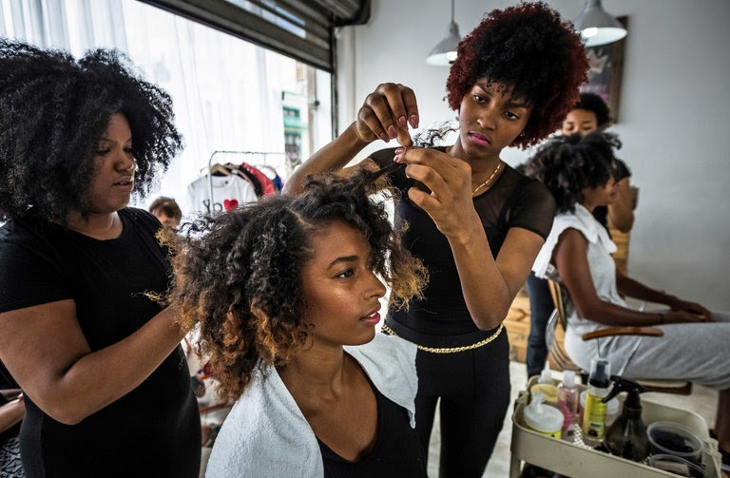
Weston and Proud
Notes:
Slide discussing the importance of careers and celebrating successes / wins. Fostering a culture of success and aspiration.

Slide 3
Preference Options
Notes:
SRO

Slide 4
Informed Choices
Notes:
SRO

Slide 5
Key Questions
What am I good at?
What am I interested in?
What do I enjoy?
Does it link to what I want to do in the future?
What will I CHOOSE and why?
Notes:
SRO

Slide 6
Compulsory Lessons
English Language
English Literature (early entry at the end of year 10)
Maths
Science*
PE
PSHE
Notes:
RCO

Slide 7
Compulsory Lessons
Attend all lessons
Fill in any gaps in your knowledge
Know your working targets
Do any pre-reading or exploration of key topics
Notes:
RCO

Slide 8
What happens next?
What you need to do
Ensure someone from home is attending on Thursday
Reflect on the presentations given/ You will also find these on our website
Talk to teachers and staff if you have any additional questions
Meet the deadline for returning your Preferences Form
What the school will do
Present key information to those from home this Thursday
3:30 – 3:50pm OR 5:15 – 5:35pm
Offer support and guidance to give you the best chance of being successful
Listen and respond to any questions you have
Do our absolute best to give you the preferences you wish
If you meet the deadline it gives the best chance of this happening
Notes:
SSI

Slide 9
Timeline
Spring 1
Roadshow Assemblies
Preference / Parents’ Evening
Pathways for students
Making decisions about choices

