Slide 1
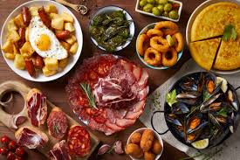
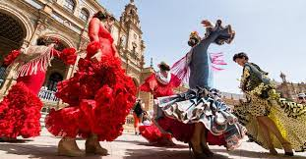
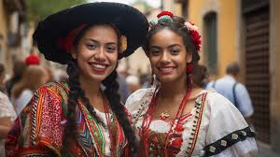
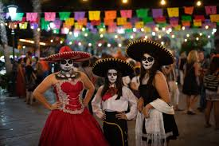
Year 9 Options Roadshow
SPANISH GCSE

Slide 2
Spanish GCSE would be difficult
and
how useful would it be for their future?
Let’s find out!

Slide 3
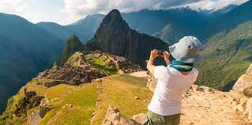
So, let’s see why learning Spanish would be useful!
https://www.youtube.com/watch?v=Q3xvmc1gVVE
Notes:
Explain how the core curriculum helps with all future careers aspirations – this is why it is a compulsory subject to study. It teaches you how to read and assess situations, communicate with others, express your ideas and feelings, to be insightful and thoughtful, a critical thinker… The focus here needs to be on English as a transferable qualification.

Slide 4
And what does the Spanish GCSE course look like?
You will be studying 3 main themes revolving around:
People and lifestyle (self and relationships with others, healthy living and lifestyle, education and work)
Popular culture (free time activities, festivals and celebrations, celeb culture)
Communication and the world around us (travel and tourism, media and social networks, the environment and where people live)

Slide 5
And what does the Spanish GCSE course look like?
Through studying these 3 main themes you will continue to:
Develop you reading and understanding skills
Develop your translation into and from Spanish
Develop your essay writing skills
Increase your fluency in speaking
Increase your understanding of other people speaking Spanish

Slide 6
How will I be assessed?
At the end of Year 11, there will be 4 exam papers
Foundation or Higher tier - all equally weighted – 25%:
Paper 1 Listening comprehension and dictation
(35 min Foundation/ 45 min Higher)
Paper 2 Speaking - photo card description, role-play and general conversation
(15 min prep time + up to 7 min speaking exam)
cont’d…

Slide 7
How will I be assessed?
At the end of Year 11, there will be 4 exams
Foundation or Higher tier - all equally weighted:
Paper 3 Reading comprehension and translation into English
(45 min Foundation/ 1h Higher)
Paper 4 Writing and translation into Spanish
(1h10 min Foundation/ 1h15 Higher)

Slide 8
What can I do in year 9 to help me be successful at KS4?
Make the most of every lesson – enjoy them!
Contribute to each lesson.
Challenge yourself every lesson by completing at least one challenge task.
Set your Netflix/ YouTube etc to Spanish audio or Spanish subtitles.
Continue developing your key skills.

