Slide 1
Year 9 Options Roadshow
Science
Combined and Separate

Slide 2
Why is science important?

Slide 3
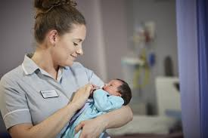
How does Science support my future aspirations?
Midwife: £34000 - £38000

Slide 4
How does Science support my future aspirations?
Vet: £32,000 - £70,000

Slide 5
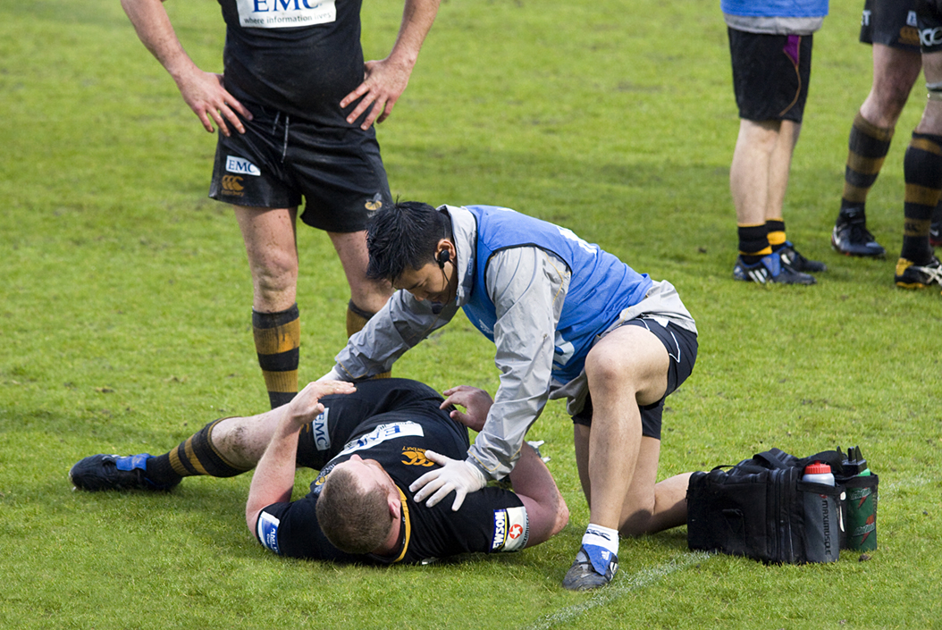
How does Science support my future aspirations?
Physiotherapist: £27,000 - £40,000

Slide 6
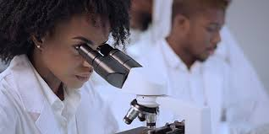
How does Science support my future aspirations?
Microbiologist: £20,000 - £80,000

Slide 7
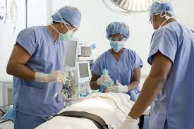
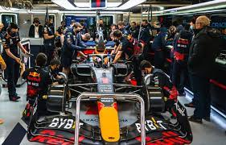
How does Science support my future aspirations?
And many, many more….
Notes:
F1 mechanic/ engineer – physics
Pilot – Physics
Surgeons/ doctors – Biology
Lego engineer – physics
Environmental scientist – Biology/ chemistry

Slide 8
Science at KS4
You will either study the following:
Combined science
Separate science

Slide 9
What does the combined course look like?
You will study biology, chemistry and physics.
You can either be entered for a higher or foundation tier exam.
Higher tier can achieve grades 4 – 9.
Foundation tier can achieve grades 1 – 5.
At the end of the course you will leave with two GCSE grades based off of how well you have performed across ALL 6 papers
Notes:
On the higher tier paper anything less than a 4 will gain a U

Slide 10
What does the separate course look like?
You will still study biology, chemistry and physics.
There is a lot more to cover so you will have to be motivated and hard working.
You can either be entered for a higher or foundation tier exam.
Higher tier can achieve grades 4 – 9.
Foundation tier can achieve grades 1 – 5.
At the end of the course you will leave with three GCSE grades, one for each science.
Notes:
On the higher tier paper anything less than a 4 will gain a U
Students can sit a higher paper on one of the sciences and a foundation on the others or any combination of these.

Slide 11
How am I assessed?
For your Science qualification there are six exams.
Two in each of the three sciences.
It does not matter if you take combined or separate there will still be six papers to sit.

Slide 12
Paper 1 content
Biology
Cell biology
Organisation
Infection and response
Bioenergetics
Chemistry
Atomic structure and the periodic table
Bonding, structure and the properties of matter.
Quantitative Chemistry
Chemical changes
Energy changes
Physics
Energy
Electricity
Particle model of matter
Atomic structure
Notes:
Combined - 1 hour 15 minutes – 70 marks – 16.7 % of overall grade for each paper
Separate – 1 hour 45 minutes – 100 marks – 50% of overall exam grade

Slide 13
Paper 2 content
Biology
Homeostasis and response
Inheritance, variation and evolution
Ecology
Chemistry
The rate and extent of chemical change
Organic chemistry
Chemical analysis
Chemistry of the atmosphere
Using resources
Physics
Forces
Waves and magnetism
Electromagnetism
Notes:
Combined - 1 hour 15 minutes – 70 marks – 16.7 % of overall grade for each paper
Separate – 1 hour 45 minutes – 100 marks – 50% of overall exam grade

