Slide 1
Year 9 Options Roadshow
Religious Studies GCSE

Slide 2
How does Religious Studies support my future aspirations?
Education
Human Resources
Management
Communication roles
Charity / support work
Law
Politics
Public Services
Tourism
Media
Health and Social Care
Journalism

Slide 3
Component 1: Religious , Philosophical and Ethical Studies in the Modern World
Written examination: 2 Hours. This is worth 50% of the qualification. You will be tested on your knowledge, understanding and evaluation of the themes.
Is abortion ok?
Is there an afterlife?
Should Euthanasia be legalised?
Matters of life and death

Slide 4
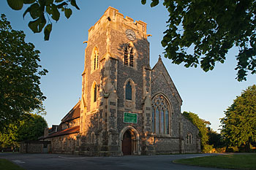
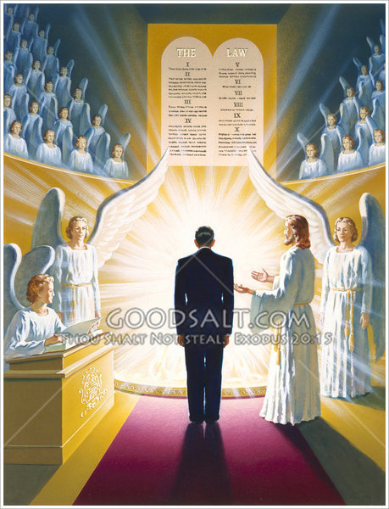
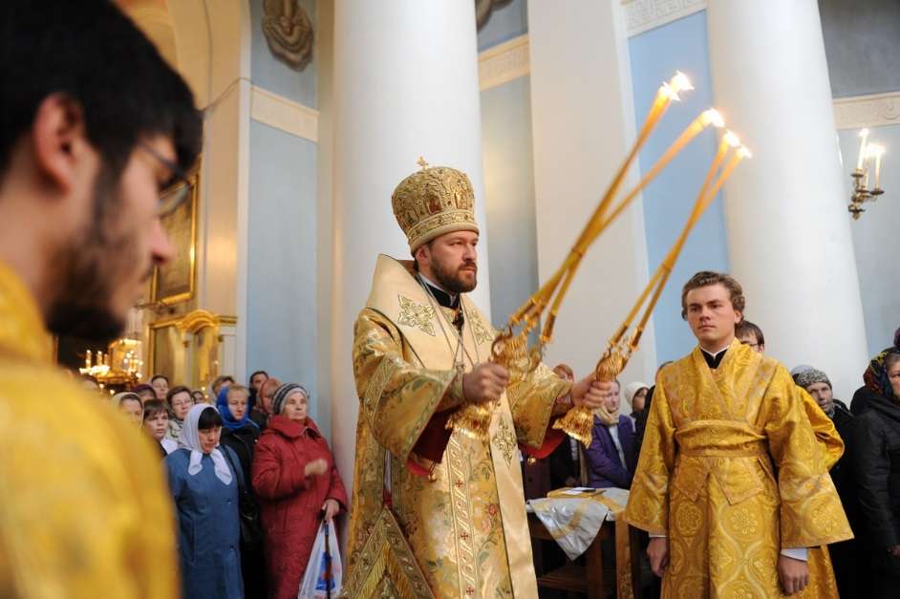
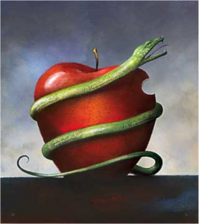
Creation
The Nature of God
The afterlife
Component 2: The Study of Christianity.
Written examination: 1 Hour. This is worth 25% of the qualification. You will be tested on your knowledge, understanding and evaluation of the subject content.
Role of the Church
Worship
Sin
Judgement

Slide 5
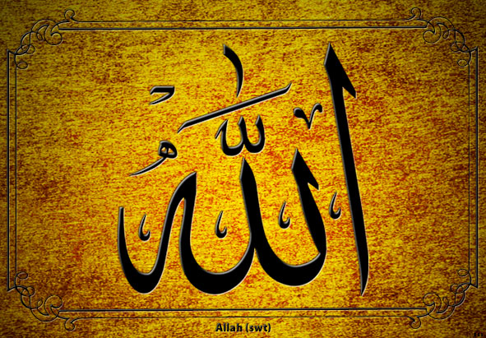
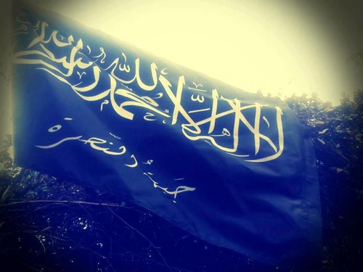
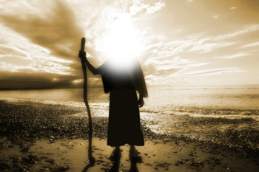
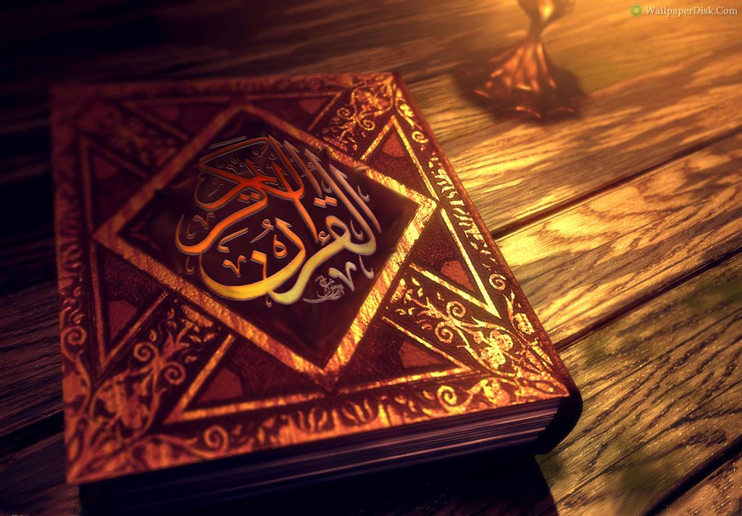
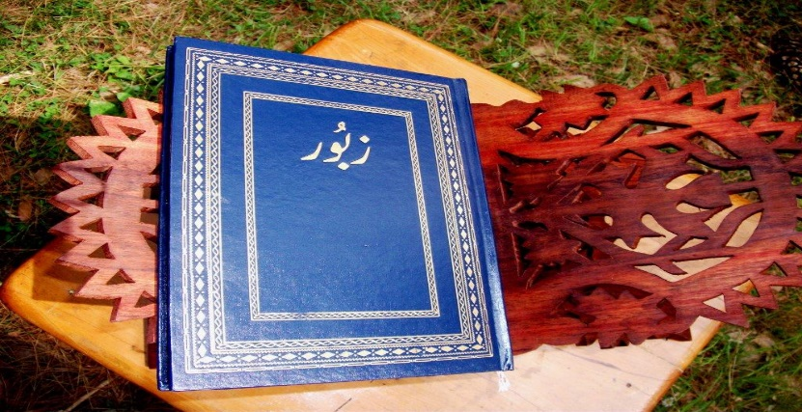
Allah
Six articles of faith
Akhirah (afterlife)
Component 3: The Study of Islam
Written examination: 1 Hour. This is worth 25% of the qualification. You will be tested on your knowledge, understanding and evaluation of the subject content.
Prophethood
The Five Roots
Zabur (Psalms)
Kutub
(books)
Angels

Slide 6
What you need to do…
You will need to show knowledge and understanding of religion and belief. There is a lot of content.
4 Topics in the philosophy and ethics unit
2 Topics in the Christianity unit
2 Topics in the Islam unit
You need to be prepared for challenging exams. Each exam is a mark a minute. 120 minute exam = 120 marks.
You need to know and use beliefs, practices and sources of authority - quotes
You need to explain the influence on individuals, communities and societies – Impact
You need to know similarities and differences within and/or between religions and beliefs - knowledge and understanding

Slide 7
How can my studies in year 9 help me be successful?
Get into good habits now.
Talk to each other more.
Read more.
Pay attention to global issues.
Be aware of religious celebrations and festivals.
Learn the key skills.

