Slide 1
Year 9 Options Roadshow
WJEC
Media Studies
GCSE

Slide 2
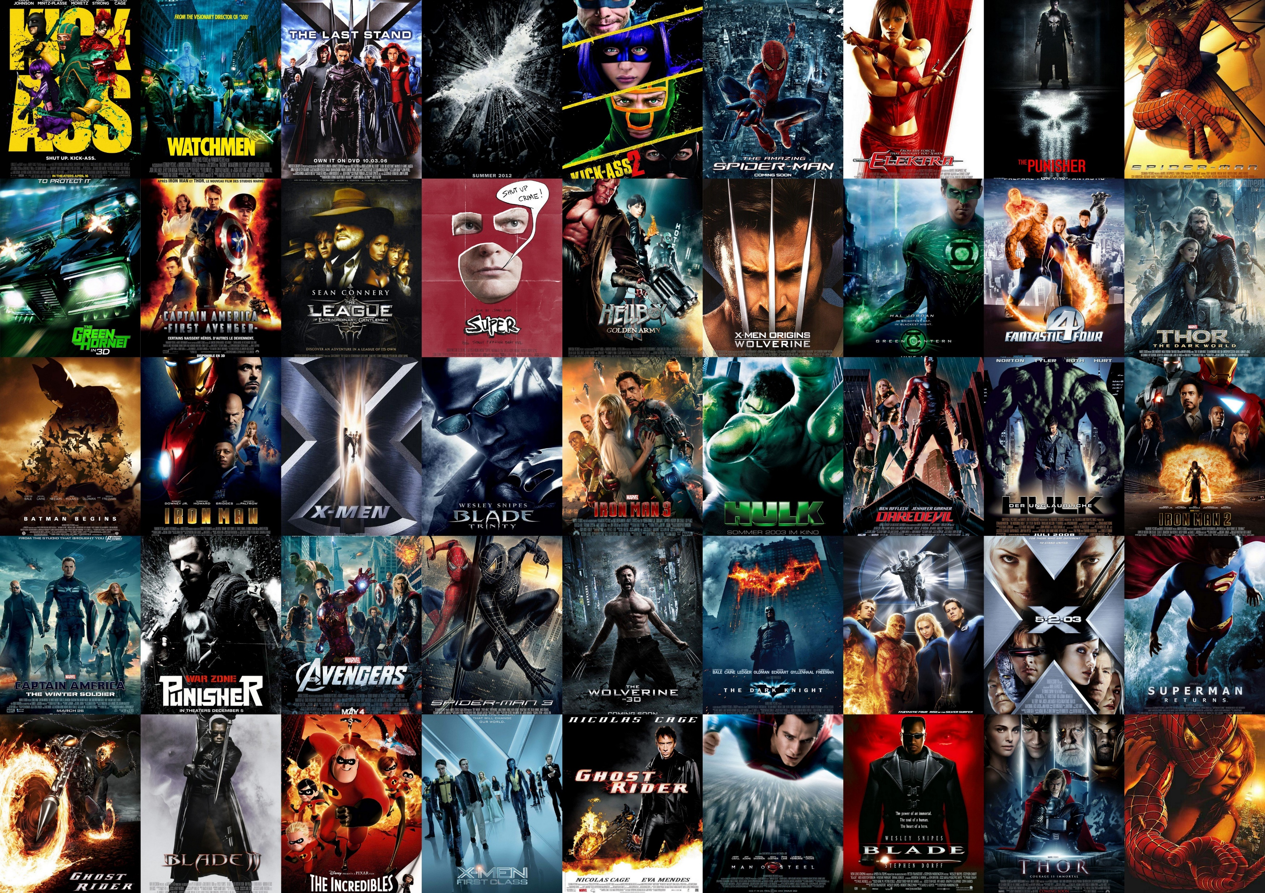
What is Media Studies?
Media studies is all about communication, particularly, mass communication.
What we watch
What we hear
What we read
The average person uses media platforms for at least 8 hours a day!

Slide 3
What does the course look like?
Media studies is about analysing how media products like TV, film, music videos, news media, games use image, sounds, language and representations to create meaning.
You will learn about the media industry and how the industry affects how products are made.
You will investigate audiences and the implications of media.

Slide 4
What does the course look like?

Slide 5
How am I assessed?
Notes:
Music videos – gender / race
Social media platforms and websites

Slide 6
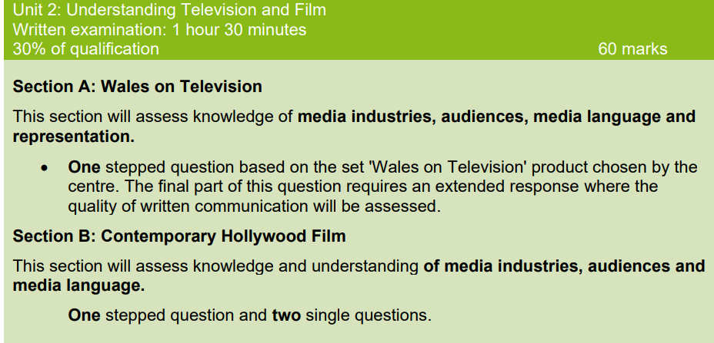
How am I assessed?
Notes:
Luther
Crime
James Bond franchise / Marvel / Hunger Games / Marvel

Slide 7
How am I assessed?
Notes:
Advertising unit – creating part of a music video / print media for a film / advertising for a film / video game – set each year by the exam board

Slide 8
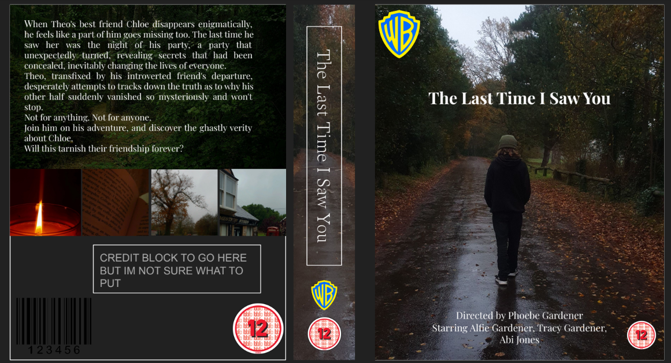

Slide 9
How can my studies in year 9 help me be successful?
IT and English skills are going to help you.
Time management – coursework component.
Writing skills – analysing texts.
Creative Arts.

Slide 10
How does Media Studies support my future aspirations?
Education
Advertising
Journalism
Film production
Theatre
Design
Business

