Slide 1
Year 9 Options Roadshow
Maths

Slide 2
Why Mathematics?
Life skills
Mathematical concepts are part of everyday life, from managing savings, loans, taxes, shopping etc.
GCSE Maths equips you with the skills needed to make decisions in real-world situations.
Problem-Solving Skills:
Maths teaches critical thinking and problem-solving skills. These skills are valuable in almost every aspect of life. The ability to analyse problems, break them down into parts, and find solutions is a transferable skill that can benefit you in various contexts.
CV
To support the study of other subjects
E.g. Biology, Geography, Physics or even Psychology(if you study it at college)
Career Opportunities:
Having a maths grade, opens the doors to a wider range of career opportunities including : science, technology, engineering, finance, data analysis.

Slide 3
Many subjects use maths…
Biology
Physics
Business
PE
Maths
Economics
Chemistry
Engineering
Psychology
Law
Geography
Computing
Sociology

Slide 4
Careers using maths
On-going applications in engineering, such as:
Aircraft Modelling
Fluid Flows
Acoustic
Software Development
Electronics
Civil Engineering.
Notes:
Images:https://pixabay.com/en/curve-background-gradient-color-2822641/
https://pixabay.com/photos/buildings-skyscraper-sky-clouds-2581875/

Slide 5
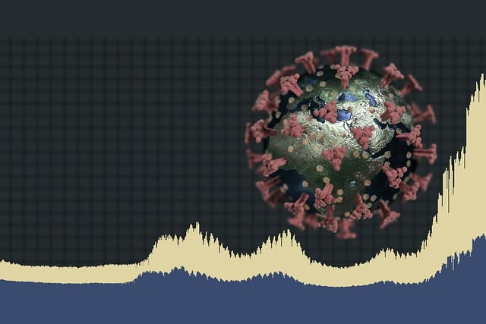
Careers using maths
New scientific processes such as:
Modelling populations
Modelling diseases
Quantum Physics
Astronomy
Forensics
DNA sequencing
Notes:
Images:https://pixabay.com/en/dna-string-biology-3d-1811955/
https://pixabay.com/illustrations/pathogen-coronavirus-statistics-6921398/

Slide 6
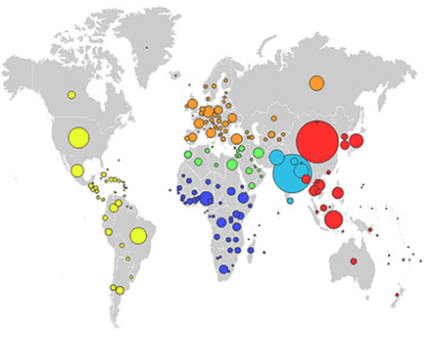
Careers using maths
Applications relating to human behaviours and interactions:
Data Science
Psychology
Law
Economics
Climate Change
Environmental Modelling
Political Science
International Development
Notes:
Images: https://www.flickr.com/photos/atariboy/497625585
https://pixabay.com/en/american-express-cards-credit-89024/
https://pixabay.com/illustrations/earth-protection-environment-globe-1987763/

Slide 7
Careers using maths
Applications of mathematics in technology:
Medical
Games Design
Internet Security
Financial Cryptography
Computing
Communications
Artificial Intelligence
Notes:
Images:https://pixabay.com/en/scifi-war-future-futuristic-robot-3617337/
https://pixabay.com/en/smartphone-screen-android-1957740/

Slide 8
What are the career opportunities?

Slide 9
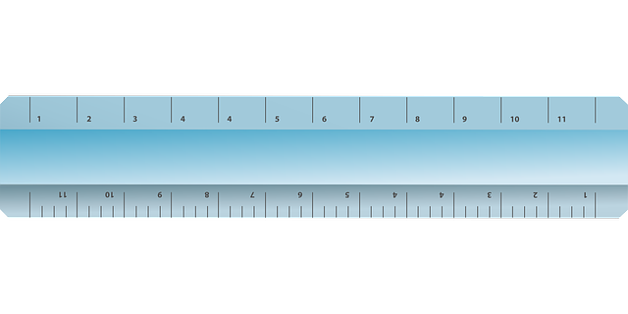
What are the career opportunities?
Average earnings five years after achieving level 3 qualifications (by subject).
Further maths | £25,500
Maths | £22,500
Physics | £23,700
Computing | £22,500
Business Studies | £21,000
Geography | £20,900
Biology | £20,600
Chemistry | £21,600
P.E. | £20,400
French | £19,900
History | £19,400
English Literature | £19,200
Sociology | £18,300
Art and Design | £16,800
Published 2019: Average earnings in the 2016/17 Tax year for learners that achieved level 3 qualifications in 2011
https://www.gov.uk/government/publications/post-16-education-earnings-outcomes-for-level-3-achievements
Notes:
Image created on Powerpoint by RB using
https://pixabay.com/vectors/eraser-school-supplies-office-23659/
https://pixabay.com/vectors/pencil-education-office-stationery-23648/
https://pixabay.com/vectors/ruler-length-measure-centimeter-155186/

Slide 10
Be aspirational!
If employers have to make a decision about who to hire, it is always going to be the candidate with secure grades in the core subjects.
A grade 4 is the minimum requirement for courses and jobs after secondary school.
If you do not secure a grade 4 you will have to resit at college.
College, university, apprenticeships and employment is competitive – you need to get the best grade you are capable of in order to take the next step on your journey.
Notes:
Focus on

Slide 11
Maths at KS4
By year 10 you will be positioned in one of the following groups:
Higher tier – You can achieve any grade from 3 to 9.
Foundation tier – You can achieve any grade from 1 to 5

Slide 12
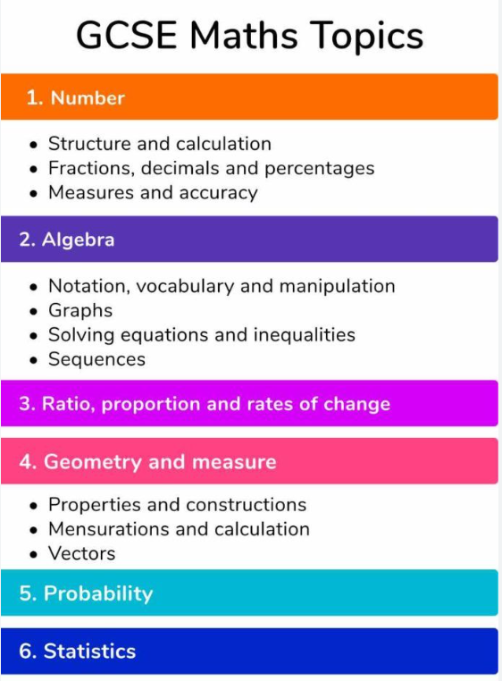
What does the course look like?
Both foundation and higher tiers are split up into 6 sections as shown.
Foundation tiers have a greater focus on the Number and Ratio topics, whereas Higher Tier has a greater focus on Algebra.

Slide 13
How am I assessed?
For your Maths qualification, there are 3 exams as follows:
Paper 1 Non Calculator Paper 33.3% 1 hour and 30 minutes
Paper 2 Calculator Paper 33.3% 1 hour and 30 minutes
Paper 3 Calculator Paper 33.3% 1 hour and 30 minutes

Slide 14
How can my studies in year 9 help me be successful?
Learn the key skills. Year 7 to 9 are key skills that form the foundation of maths. Do not be shy to ask the teacher if you do not understand the learning.
Practise outside of school – Google classrooms, homework on Seneca Learning and mathsgenie are all different way of revising the content covered in school.
Some topics in year 9 are not covered again till 2 years later in year 11! So revision is key.

