Slide 1
Year 9 Options Roadshow
History GCSE

Slide 2
Why study it?

Slide 3
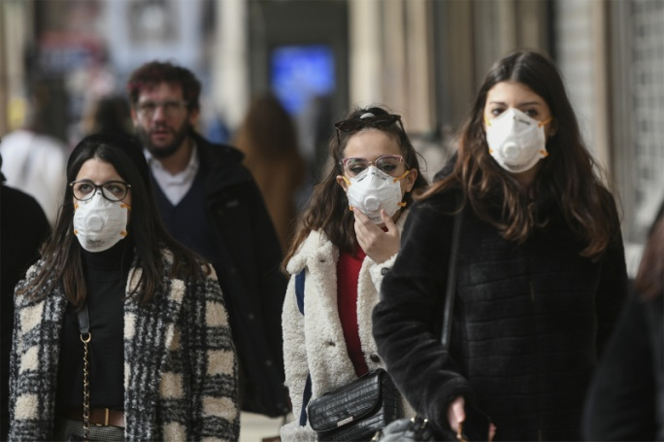
Studying History gives you a balanced outlook on the world and will help you understand the world around you today!
Viral pandemics
Conflicts around the world
Rising prices in the shops.

Slide 4
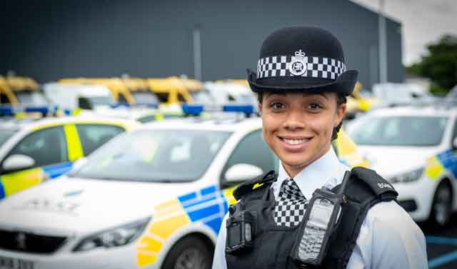
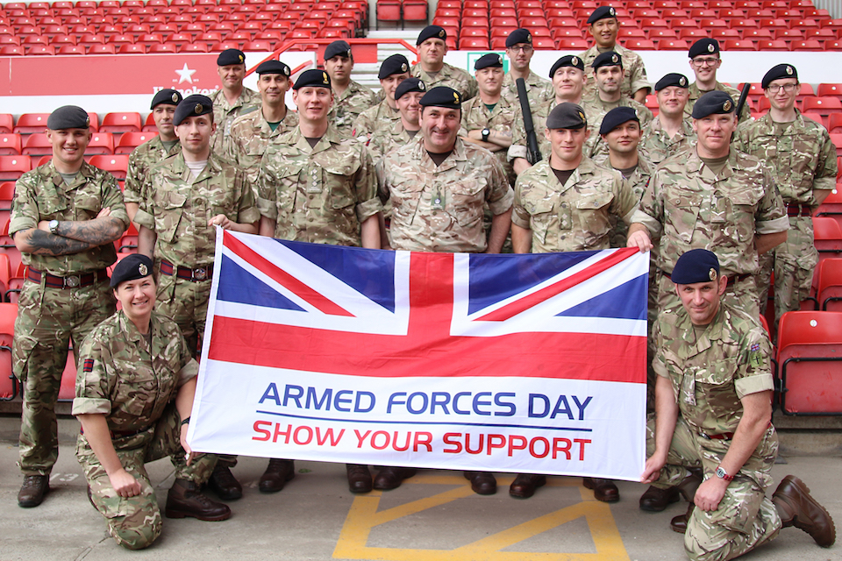
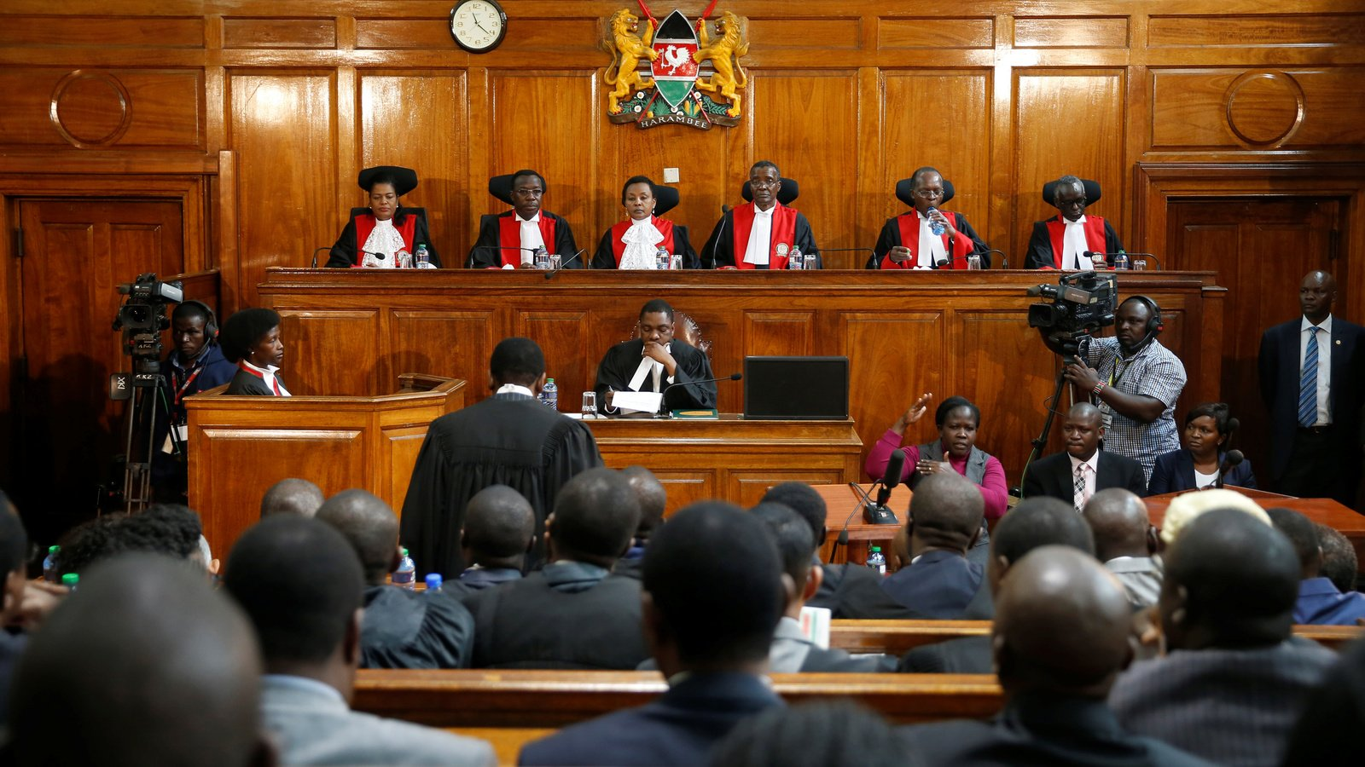
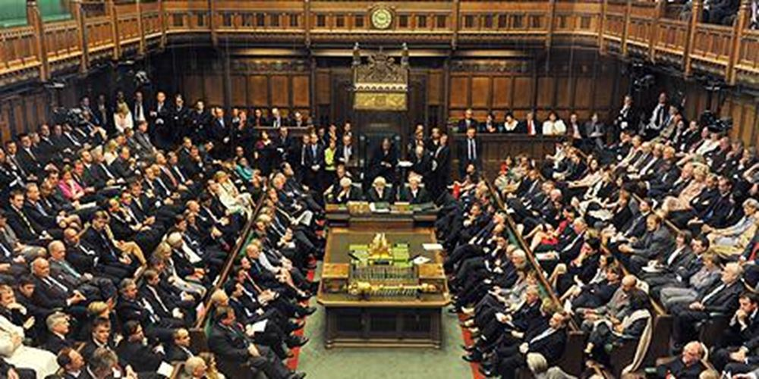
How does History support my future aspirations?
Human Resources
Police / armed services
Business / marketing
Communication roles
Charity / support work
Law / politics
Writing / journalism
Education

Slide 5
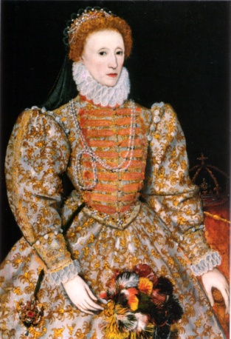
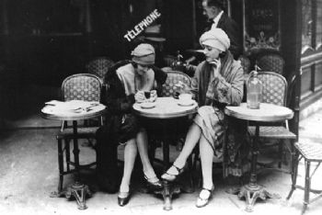
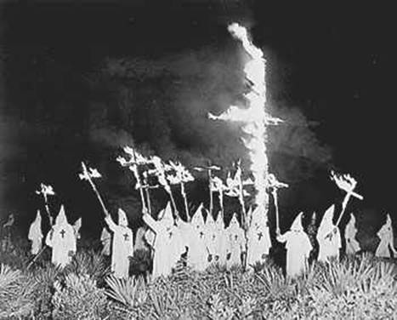
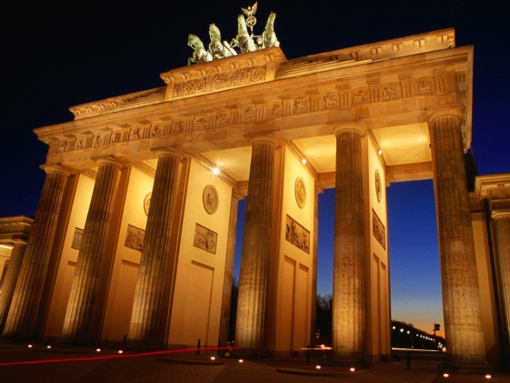
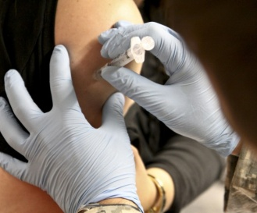
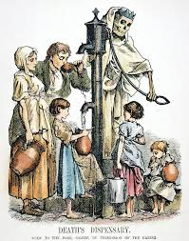
What does the course look like?
Paper 1: Studies in Depth
Unit 1: Elizabethan Age, 1558-1603. 1 hour exam (Studied at the end of Year 10 and 11)
Unit 2: The USA, 1910-1929. 1 hour exam. (Studied in Year 10)
Paper 2: Studies in Breadth
Unit 3: The Development of Germany, 1919-1991. 45 minute exam (Studied in Year 10)
Unit 4: Changes in Health and Medicine in Britain, c.500 to the present day. 1 hour 15 minute exam. (Studied in Year 11)

Slide 6
How am I assessed?
The exam papers test you on your historical knowledge and historical skills.
Analyse and evaluate historical sources and interpretations.
Explain causes and consequences and then reach judgments.
Explain the significance of people and events.
Consider the changes and continuities over periods of time.
Communicate with others and debate.
Literacy and essay writing.

Slide 7
Be aspirational!
A grade 4 is the minimum requirement for KS5, employment and training.
However, colleges are prioritising grade 5+ to access A level courses.
College, university, apprenticeships and employment is competitive – you need to get the best grade you are capable of in order to take the next step on your journey.
Notes:
Focus on if employers have to make a decision about who to hire, it is always going to be the candidate with secure grades in the core subjects.

Slide 8
How can my studies in year 9 help me be successful?
Get into good habits of punctuality and attendance.
Develop your background knowledge.
Practice the key skills that will be needed at GCSE.
Encourage you to read more.

Slide 9
