Slide 1
GCSE
GEOGRAPHY

Slide 2
Why can rivers be deadly?
Why do people live near rivers that flood?
Changing Environments
RIVERS

Slide 3
Changing Environments
COASTS
Why are millions of properties at risk of falling into the sea?
How should we protect our coastlines?

Slide 4
Changing Environments
WEATHER AND CLIMATE
Are hurricanes the deadliest natural hazard?
What if the UK was hit by a drought?
Notes:
You will learn about earthquakes, tsunami, hurricanes (how they’re caused, the effect on people and how people should respond)

Slide 5
What if all the world’s rainforests were cut down?
How do plants and animals survive here?
Environmental
Challenges
Notes:
Rainforests and semi arid environments

Slide 6
Environmental
Challenges
What if desertification continues?
Are we running out of water?

Slide 7
Changing Places –
Changing Economies
What jobs will there be in the future?
How will new technology affect business and trade?
Notes:
Globalisation, business, jobs, technology, TNCs

Slide 8
Are cities in crisis?
What if there was no countryside?
Changing Places –
Changing Economies
Notes:
You will learn about two of the most important global cities– Southampton (UK) and Mumbai (India)

Slide 9
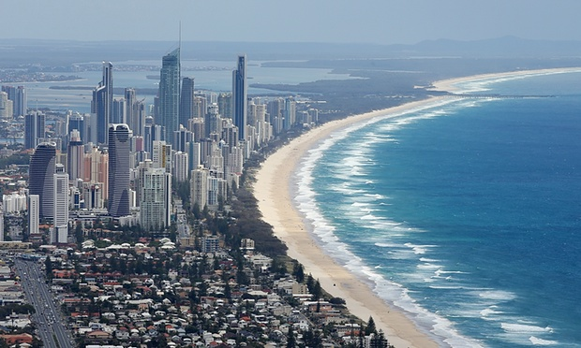
“Geography is all the rage.”
“Geography is a subject for our times.”
“Geography is soaring in popularity.”
Notes:
Geography is one of the most popular option choices at GCSE with over a third of pupils in England taking the subject. Geography is not only up-to-date and relevant, it is one of the most exciting, adventurous and valuable subjects to study at GCSE level. So important, in fact, that the Guardian newspaper in 2015 named Geography as a ‘must-have A-Level’ to help you make sense of the world.
Geography marries together the world of hard scientific fact and process, with human interaction and reaction, through skilful application. That is the strength. We don’t study for the sake of it, we problem solve. We don’t learn skills to sit in a room and stare at them, we go out and fix issues

Slide 10
Pupils who have studied Geography have gone on to work in the following sectors: law, science, sales, business, environment, information technology, management, finance, banking, marketing, research, manufacturing, teaching, childcare, engineering and building, arts, design and media, town planning, working abroad and many (many) more…

Slide 11
debating and arguing your point
fieldwork
map skills
modern computer based mapping
interpreting photos, cartoons, diagrams…
working with data
statistics
digital technologies
convincing others you are right
critical analysis
decision making
analysing articles
investigating issues in the real world
report writing
empathy
boosting your memory
problem solving
a wide variety of
SKILLS
Notes:
Such a wide variety of skills gained in Geography will be useful after school. These skills are highly sought after by Sixth Form Colleges, universities and employers.

Slide 12
Skills developed through high quality
FIELDWORK

Slide 13
How will I be assessed?
Three examinations at the end of Year 11:
Component 1 (1hr 45mins) tests all 3 themes
Component 2 (1hr 30mins) contains a Decision Making Exercise
Component 3 (1hr 30mins) tests Fieldwork

Slide 14
Should I do geography GCSE?
Maybe…..
are interested in the subject and the world around you (really important!)
are a good ‘all-rounder’ and/or be committed to work on areas you may find trickier
have good enquiry skills (i.e. good scientists)
don’t mind working with numbers occasionally!

