Slide 1
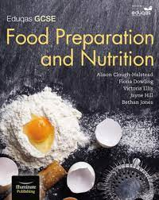
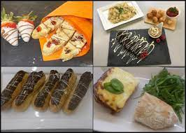
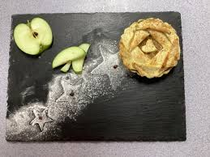
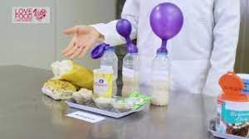
Year 9 Options
FOOD PREPERATION AND NUTRITION
GCSE

Slide 2
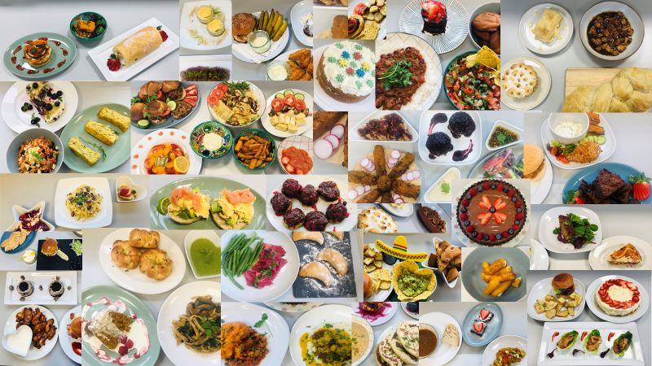
So, what’s it all about?
Instilling a LOVE of cooking..
Notes:
Explain how the core curriculum helps with all future careers aspirations – this is why it is a compulsory subject to study. It teaches you how to read and assess situations, communicate with others, express your ideas and feelings, to be insightful and thoughtful, a critical thinker… The focus here needs to be on English as a transferable qualification.

Slide 3
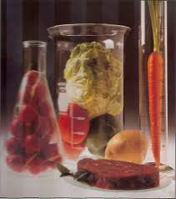
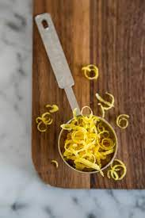
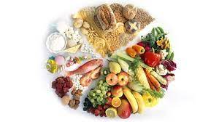
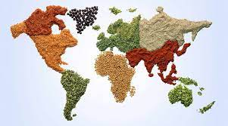
Subject content – What is covered?
You will be studying:
1. Food commodities
2. Principles of nutrition
3. Diet and good health
4. The science of food
5. Where food comes from
6. Cooking and food preparation

Slide 4
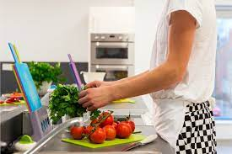
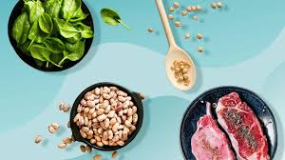
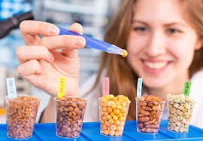
What does the Food Preparation GCSE course look like?
Through study you will continue to:
Develop your knowledge and understanding of the areas of content.
Develop technical skills through practical and experimental work.
Explore and consolidate knowledge and understanding relating to food preparation and nutrition.

Slide 5
How will I be assessed?
At the end of Year 11, there will be a written examination paper:
It will be based on: Principles of Food Preparation and Nutrition
Length of the examination: 1 hour 45 minutes
50% of the qualification

Slide 6
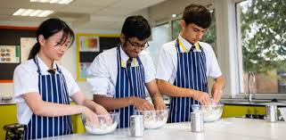
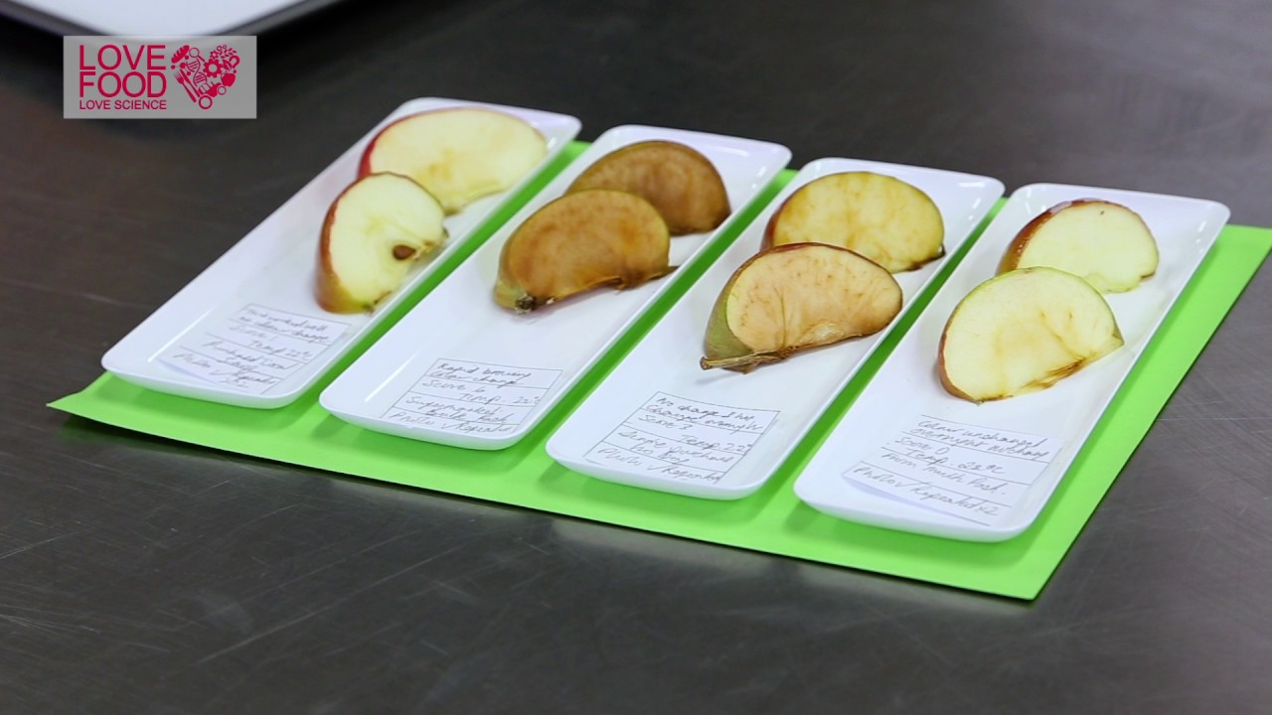
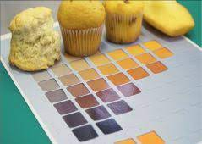
How will I be assessed?
Year 11 will be focused on Non-Examined Assessments.
Assessment 1: The Food Investigation Assessment
This will assess knowledge, skills and understanding in relation to scientific principles underlying the preparation and cooking of food.
Assessment 1: 8 hours
Value: 15%

Slide 7
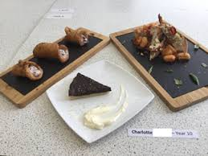
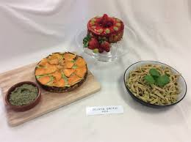
How will I be assessed?
Year 11 will be focused on Non-Examined Assessments
Assessment 2: The Food Preparation Assessment
Prepare, cook and present a menu which assesses knowledge, skills and understanding in relation to the planning, preparation, cooking and presentation of food.
Assessment 2: 12 hours
Value: 35%

Slide 8
What can I do in year 9 to help me be successful at KS4?
Use the lesson time to learn, nurture and develop your knowledge and skills.
Be prepared; take responsibility, arrive on time and ensure that you bring what you need to class.
Demonstrate safe working practices, show you are confident and competent in the kitchen.
Be creative, and be willing to experiment with foods.
Continue developing your knowledge and practical skills outside of the classroom.
Be open to constructive comments in relation to your work and always strive to do better.

Slide 9
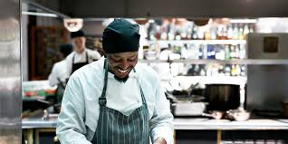
Career Implications
Studying this subject may lead to a wide variety of career paths, including those involving management, problem solving and decision making.
These might include Chef, Dietician or Nutritionist, Product Development, Food Production Industry, Supermarket related roles, Hotel Management, Environmental Health Officer or Food Teacher.

