Slide 1
Studying GCSE Art/Photography at Weston Secondary
Where could it take you?

Slide 2
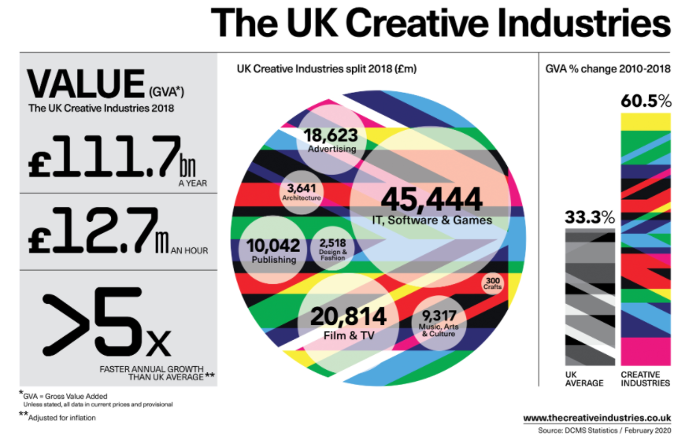
Why work in the creative sector?
Did you know more people work in the creative industries than the finance industry!
Employs over 2.8 million people.
Notes:
Creative jobs are growing at twice the UK Economy average

Slide 3
Art and design opens the door to lots of industries
Creative Technology
TV and Film
Advertising
Publishing
Arts, Culture and Music
Architecture
Fashion and Design
Crafts

Slide 4
There are jobs directly to do with Art:
Fine Artist
Gallery Curator
Art Therapist
Art Teacher/ Lecturer
Technician
Art Valuer/Auctioneer
Illustrator
Conservator

Slide 5
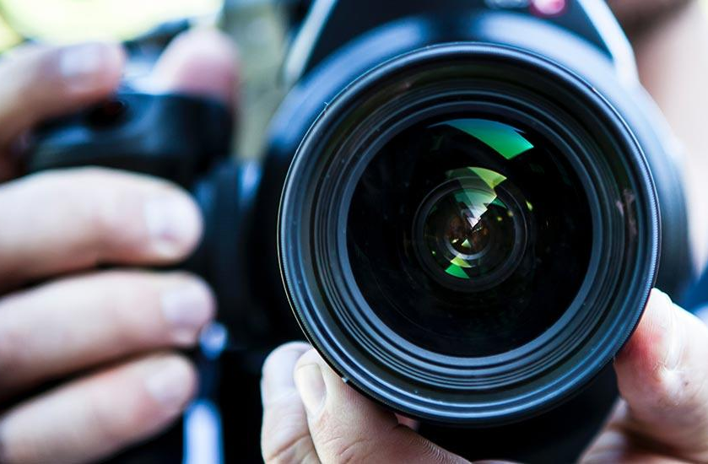
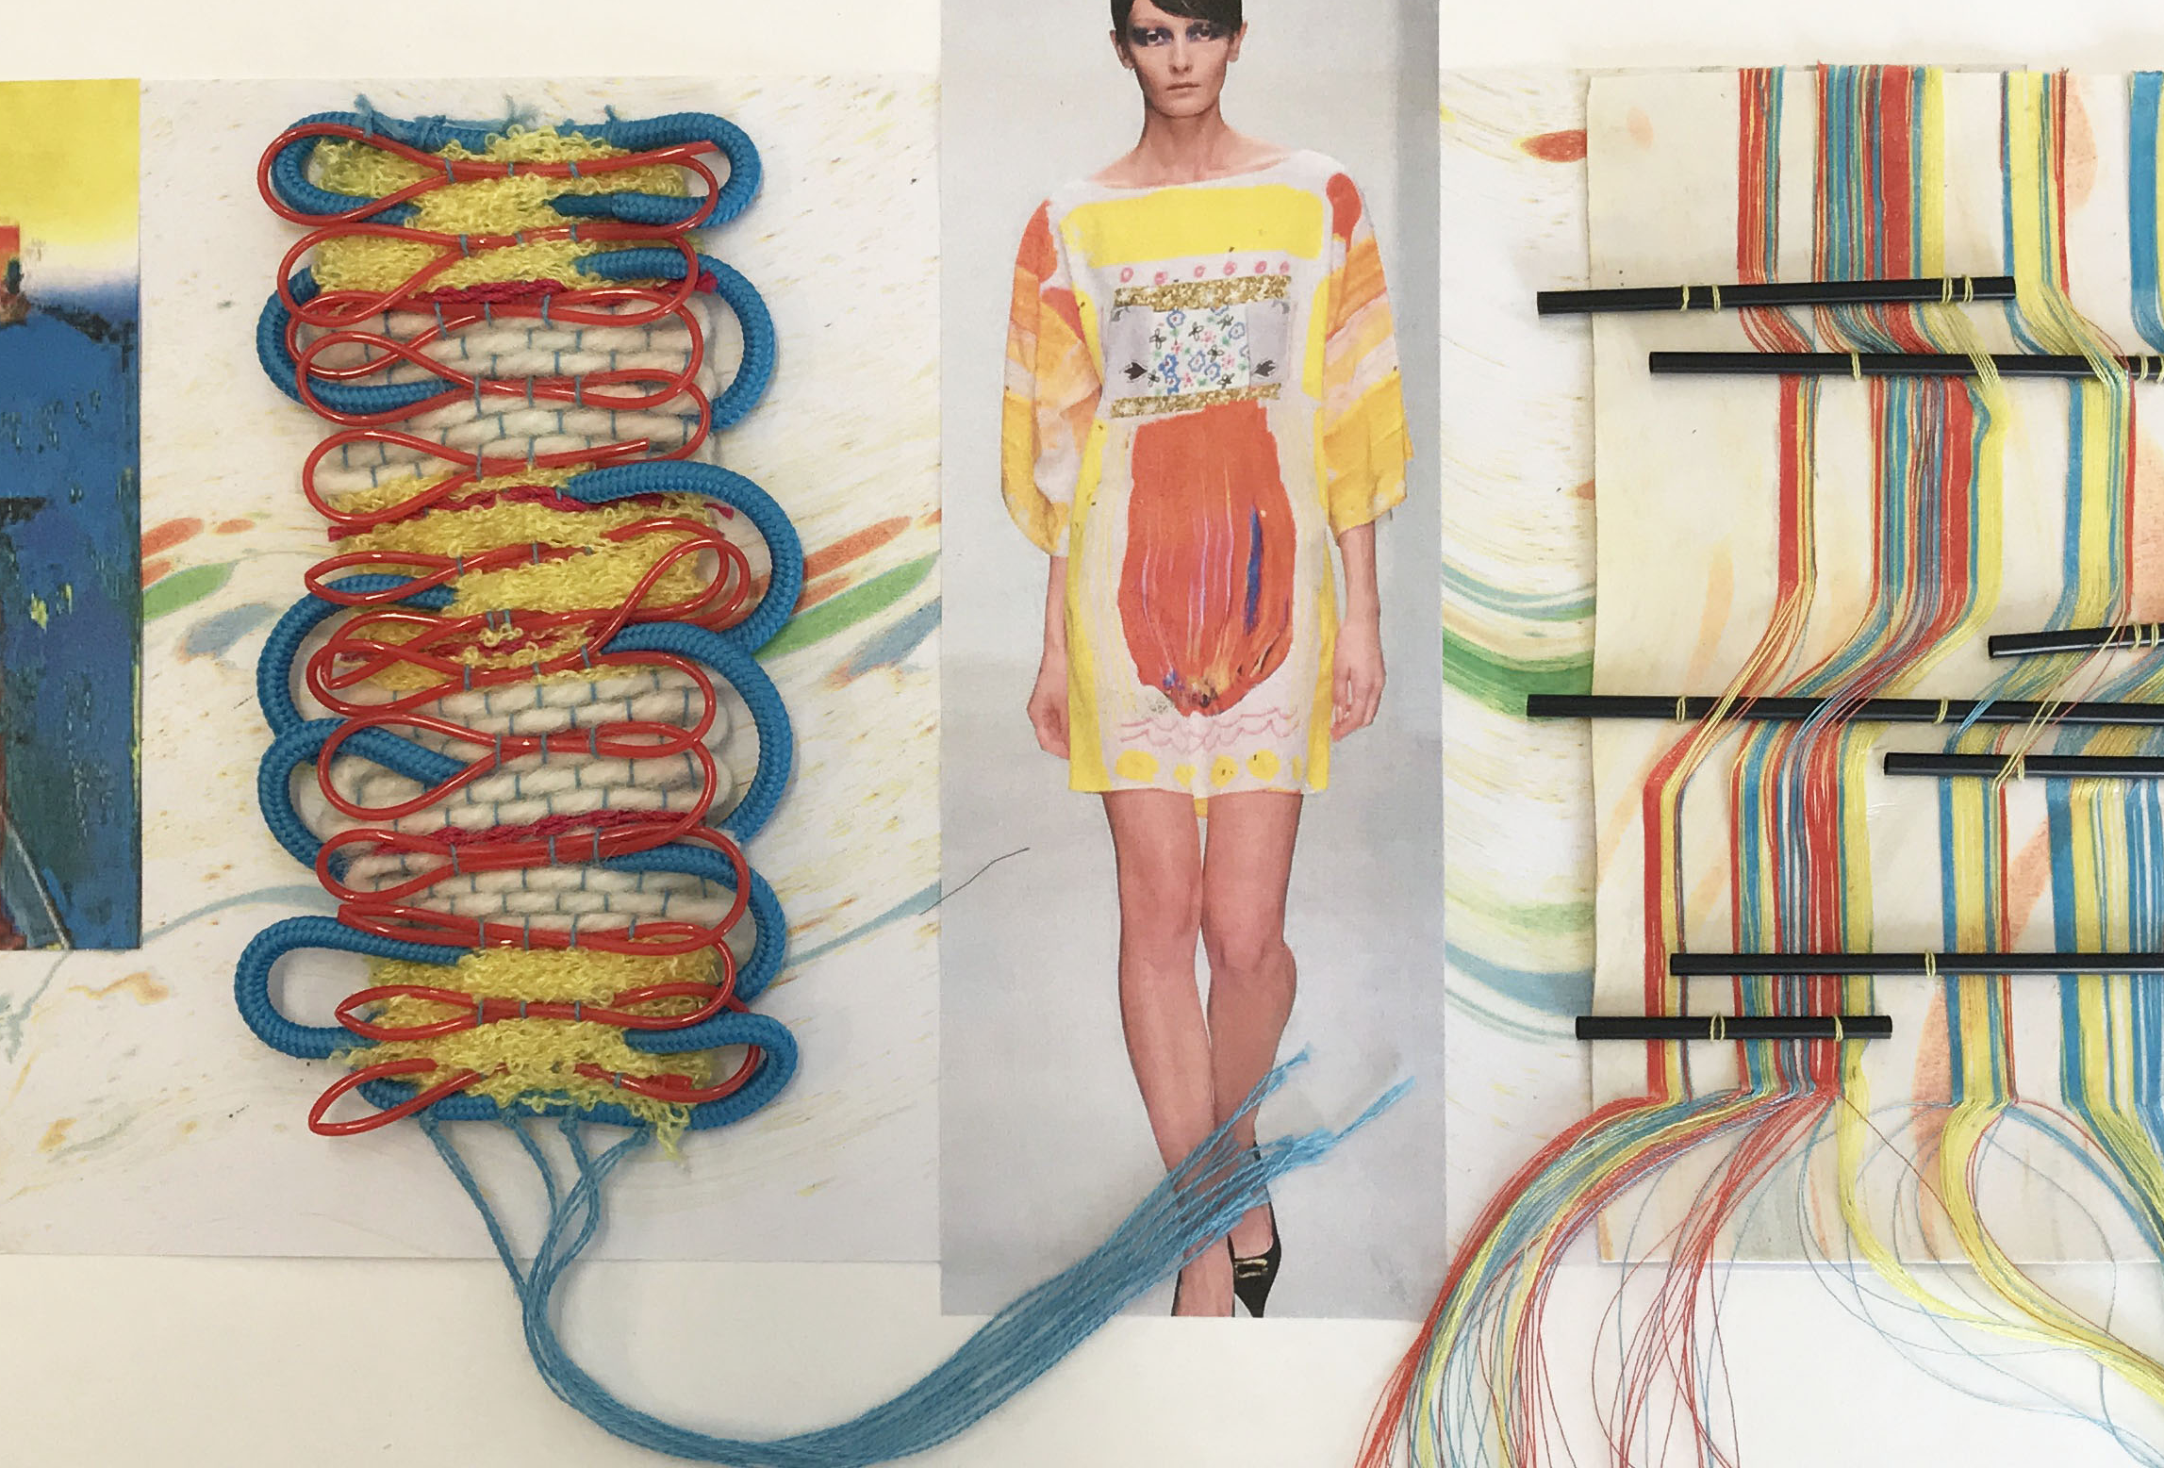
Artistic jobs in other industries
Media, Film, Theatre:
Web design
Graphic Design
Photographer
Set Design
Costume Design
Make-up artist
Lighting technician
Art Director
Cinematographer
Film/Video Editor
Architecture:
Building design
Landscape Architect
Fashion:
Jewellery
Shoe
Bags and accessories
Textiles design
Stylist

Slide 6
9 reasons why?
The internet has created an explosion of opportunity for digital designers and multimedia artists.
Fine artists can reach a worldwide market at the click of a button
Those with a wide skill set have an advantage, in any career
Studying Art improves performance in other subjects
Good marks impress, no matter what
Art marks are not solely dependent on an exam
Coursework teaches you self-discipline
Art makes you happy
Notes:
If you enjoy being creative, want to increase your practical skills and improve your analytical, communication and research abilities, art and design is a great choice. The skills you gain make it a great complement to other subjects. Art and design is a way of seeing things and making sense of the world around you. It can help you with further study and prepare you for the world of work.

Slide 7
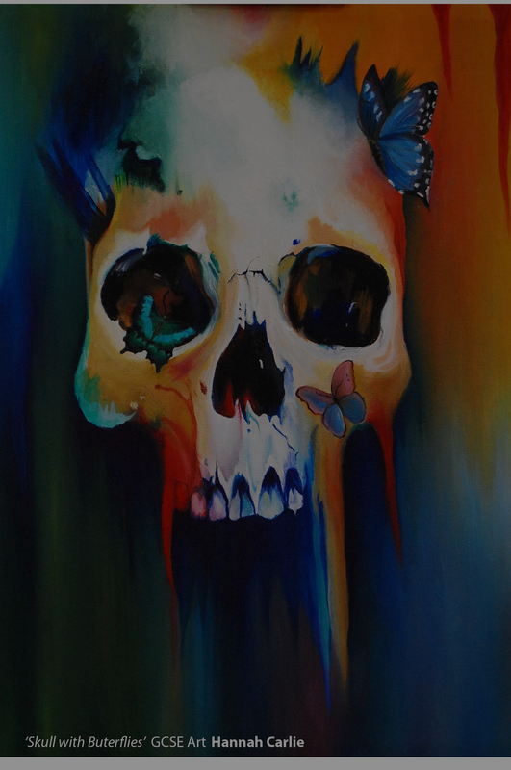
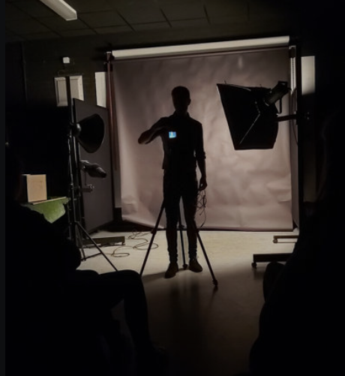
What we offer:
GCSE: Fine Art
Fine art explores ideas, conveys experiences or responds to a theme or issue of personal significance. The areas of study are very broad and cover drawing, painting, sculpture, installation and mixed media.
GCSE:PHOTOGRAPHY
Produce images using light-sensitive materials such as photographic film, or digital methods of development and production to create static or moving images. Areas of study could include portraiture, installation, photo-journalism, moving image: film, video and animation and fashion photography.

Slide 8
How will you be assessed?
• Component 1 Portfolio: produce a sustained project and a selection of further work that represents the course of study. This is worth 60% of your overall marks.
• Component 2 Externally set assignment: there’s a separate externally set task paper for each title. It features seven tasks and you have to complete one of them. You get preparation time, plus ten hours of supervised time. This is worth 40% of your total marks.

Slide 9
How will you be assessed?
AO1 – Investigating themes and the work of other artists.
AO2- Developing ideas – experimenting with art techniques and materials.
AO3 – Written and Visual Language skills.
AO4 – Response – Personal and meaningful work of your own.

Slide 10
AQA GCSE Fine Art
Unit 1 – Portfolio Submission
Yr 10 and Term 1 – Yr 11
60% of final grade.
One major sustained project and other supporting evidence.
Work selected from year 10 and year 11 Term 1 Projects:
Unit 2 Submission – Externally Set Assignment
40% of final grade.
This is set by the Exam Board
Paper given to you in January, Yr 11
10 -12 weeks to produce evidence for
AO1, AO2 and AO3
10 Hour controlled assessment
Completed across 2 days to produce your final work.

Slide 11
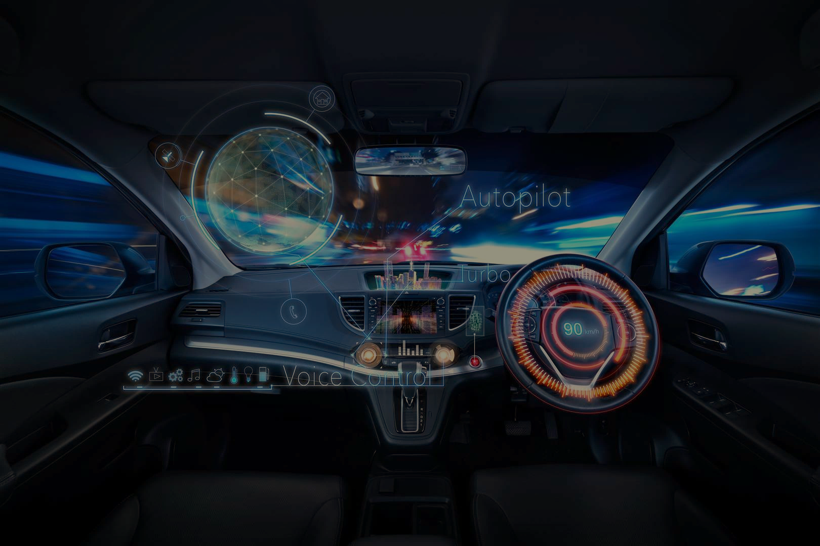
New Technology and Innovations Manger
Further Education
Art and Design B-Tec
Vocational – Level 3
Higher Education
BA (Hons) Product Design
Post Graduate Education
Masters in Innovation Management
Responsibility: Look for new innovative solutions for new automotive product design. Explores Emerging tech and see how it can be used in future car design.
Manages a team of 9
Clients: Anyone from Ferrari to Ford
Travel – USA, Europe and Australia
Salary - £20,000 - £65,000 plus
“The best thing about my job is seeing a concept become a touchable reality”

Slide 12
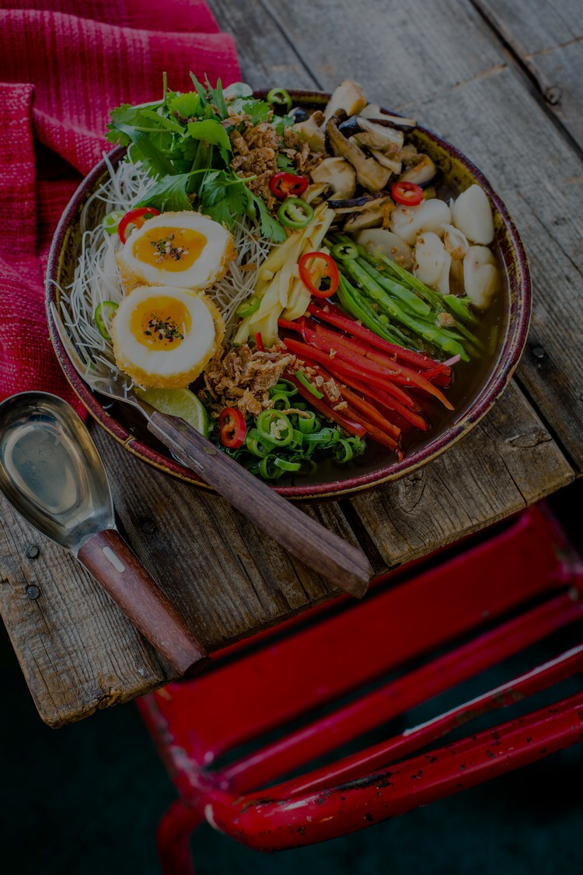
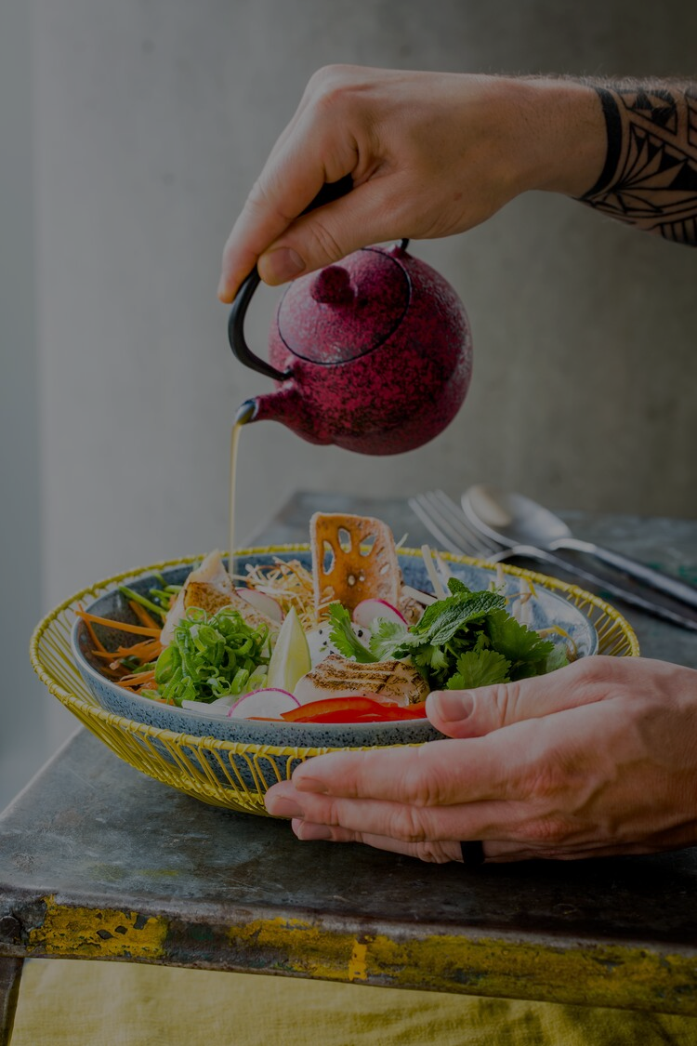
Reportage and Food Photographer
Further Education
A -Level Photography , Philosophy and Environmental Science.
Level 3
Higher Education
BA (Hons) Lens Based Media
First Job
Trainee Photographer Venture Portraits
Responsibility: The food photographer takes pictures of food for packaging, magazine articles, cookbooks, and advertisements.
Clients: Growhay, McDonalds, Butlins
Travel – UK and Europe
Salary - £22-32,000. Many photographers are freelance.
“I like the variety, I like working with lots
of different people. No two shoots are the same”

Slide 13
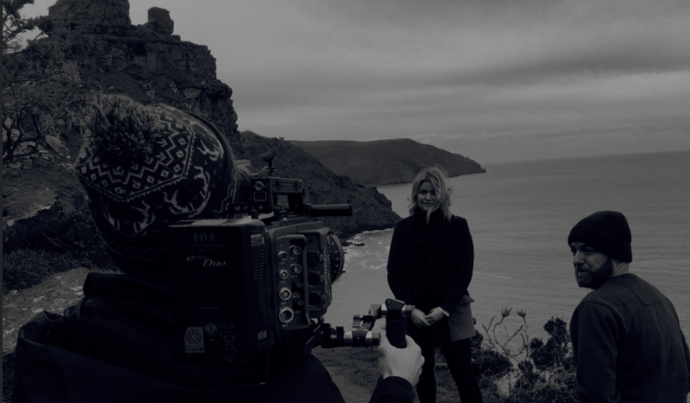
Director Mechanical Mouse Video Production Company
Responsibility: To promote client brands through use of digital video.
Clients: Nike, Mercades, BMW, Google, Audi
Travel: All over the world
Salary – Starting salary as a cameraman £29,000
Further Education
First Course - Mechanic
Re-trained Access Course in Art and Film
Vocational – Level 3
Higher Education
BA (Hons) Visual Communication : Lens Based Media
First Job
Junior Camera Operator – Live TV
“The best thing about my job is the travelling. I get to go to all of the places I’ve seen in films, eat nice food and meet lots of people.”

Slide 14
When I leave school, where do I start?
AS and A Levels
Vocational Qualification Levels 2 and 3
If you don’t want to take your studies further, the transferable skills you will gain are invaluable. You’ll develop problem solving, creative thinking, investigation, research, communication and teamwork skills, and gain the ability to develop, refine and present ideas. Employers and universities regard all of these highly!

Slide 15
Further Education
Graphic Design Degree
Design for publishing degree
Illustration degree.
Product design degree
Jewellery design degree
Fashion design degree.
Video game design degree
Web design degree
Interactive Design degree.
Interior design degree
Exhibition design degree
Set design degree

