Slide 1
Edexcel Level 2 GCSE Drama
You will develop an understanding of Drama and Theatre Arts from the perspective of a…….
Director
Designer
Actor

Slide 2
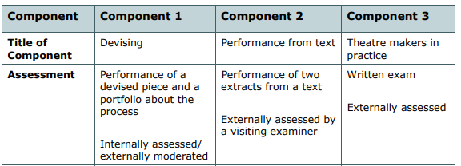
What does the course look like?

Slide 3
Component 1 (Year 10)
You will learn how to create a devised performance.
For the Practical Exam you will work in a small group to create a lengthy performance that is well organised and rehearsed. That is shown to a live audience for the assessment.
Component 1 also includes a written section where you will be asked to write a 2000 word Portfolio explaining your ideas and analysing your performance.

Slide 4
Component 2
Two scripted extracts from a play are performed to a visiting examiner and invited audience.
As an alternative to acting – you can be assessed on the technical components of sound or lighting.

Slide 5
Component 3
A play text is studied and explored in lessons from the perspective of an actor, director and designer. Your learning is tested in a written exam paper. Along with questions that require you to review a Professional Theatre Performance.
You will be taken on Theatre Trips to prepare for this section of the paper.

Slide 6
This is an academic GCSE course. The weighting between practical and written components is the same as A level.
30% of the marks are achieved through practical performance or technical demonstration.
70% of the marks are achieved through your written work – the Portfolio and the Exam paper.

Slide 7
The written components of the course provide a solid basis to progress to A level subjects like English, Languages, Media and Communications, Visual arts, Performing arts, Philosophy, History, Theatre Studies. As the route to a Bachelor of the Arts Degree.
The practical elements of the course provide a basis for vocational courses like……
Acting or Musical Theatre
Theatrical Hair and Media Make-up Diploma
The Production Arts Level 3 Diploma

Slide 8
Drama allows you to develop hugely valuable transferable skills which you will continue to use throughout your life, in and out of work.
Abilities like…..
Self-Confidence
Communication and presentation skills
Critical thinking and problem solving
Spontaneity and creativity

Slide 9
Careers in Theatre…
Actor
Director
Producer
Stage Manager
Costume Designer
Set Designer
Playwright
Lighting Designer
Lighting Technician
Dramatic Sound Design
Sound Engineer
Props Designer
Stage Crew
Marketing Manager
Sales Manager

Slide 10
Careers outside the theatre…
Arts Administrator
Broadcast Journalist
Drama Teacher
Drama Therapist
Media Researcher
Talent Agent
Theatre Reviewer
Community Arts Worker
Creative Marketing Manager

Slide 11
How can I prepare?
Build your Cultural Capital – watch plays, go to the theatre, develop an understanding of different styles and techniques
See TSA for the login details to digital theatre plus
Get involved in the school production
Look at extra-curricular opportunities outside school – the Mast Mayflower Studios

