Slide 1
Year 9 Options Roadshow
Computer Science and iMedia

Slide 2
What is computer science?
Computer Science is…
Understanding how computers work
Problem solving using computers
Creating solutions by writing, testing and evaluating programs

Slide 3
How does Computer Science support my future aspirations?
Applications developer
Cyber security analyst
Data analyst
Forensic computer analyst
Games developer
Machine learning engineer
Penetration tester
Software engineer

Slide 4
Be aspirational!
Computer Science is one of the hardest subjects that you will study!
It is combining science, languages and problem solving!
You need a growth mindset because when you problem solve and code - you will make mistakes!

Slide 5
Computer Science at KS4
You will study the following:
Computer Systems
Computational thinking, algorithms and programming
Learn even more Python coding

Slide 6
What does the course look like?
Computer Systems
Systems architecture
Memory and storage
Networks
Network security
System software
Ethical, environmental, cultural and legal issues
Computational thinking, algorithms and programming
Algorithms
Programming techniques
Robust systems
Logic
Translators and IDEs

Slide 7
How am I assessed?
For your Computer Science qualification, there are two exams:
Paper 1 Computer Systems (50% 1 hour and 30 minutes - Paper based)
Paper 2 Computational thinking, algorithms and programming (50% 1 hours and 30 minutes - Paper based)
Paper 2 includes having to hand write Python code to solve some problems

Slide 8
Computer Science post 16
Achieving a Computer Science GCSE can open the following pathways at college:
A-Level Computer Science
Level 3 Extended Diploma in Games Development
T Level in Digital Support Services

Slide 9
What is iMedia?
iMedia is…
Understanding the digital media industry
Planning, creating and designing products for clients, based on a brief
It is NOT watching and analysing media, looking at themes (like GCSE Media)

Slide 10
How does iMedia support my future aspirations?
Creative director
Web designer
Photo editor
Video & film editor
Graphic designer
Product designer
Multimedia artist
Animation/animator
Art director

Slide 11
iMedia at KS4
You will study the following units:
R093 - Creative iMedia in the media industry
R094 - Visual identity and digital graphics
R097 - Interactive digital media (websites)

Slide 12
What does the course look like?
iMedia is a design focused course
You will study what the media industry looks like, the jobs, techniques, conventions and processes used in this industry.
You will complete 2 controlled assessments (Coursework) where you will plan, create and evaluate products based on a client brief.

Slide 13
How am I assessed?
For your iMedia qualification, there are two controlled assessments (coursework) and one exam:
Exam Creative iMedia in the media industry (40% - 1 hour and 30 minutes - paper based exam - done in June in year 11)
CA 1 Visual identity and digital graphics (25% - 10 hour controlled assessment - Done in year 10)
CA 2 Interactive digital media (35% - 15 hour controlled assessment - Done in year 11)
Controlled assessments must be your own work - No AI or teacher help!

Slide 14
iMedia post 16
Achieving a Level 1/Level 2 iMedia qualification can open the following pathways at college:
A Level Media Studies
Apprenticeship - Media and Broadcast assistant (Level 3)
Cambridge Technicals - IT & Digital Media
T Level - Digital Production Design or Media, Broadcast & Production

Slide 15
How can my studies in year 9 help me be successful?
Get into good habits now.
Practice coding (CS)
Read tech articles (CS)
Practice image editing skills (iMedia)
Think about why you do things (iMedia)

Slide 16
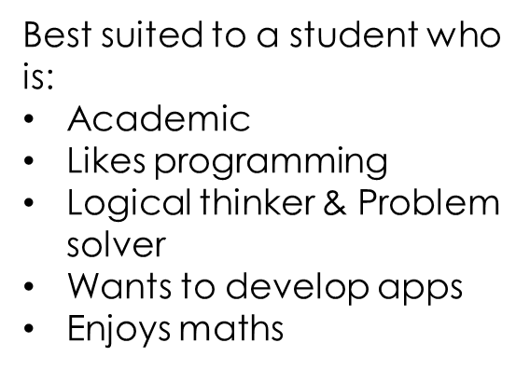
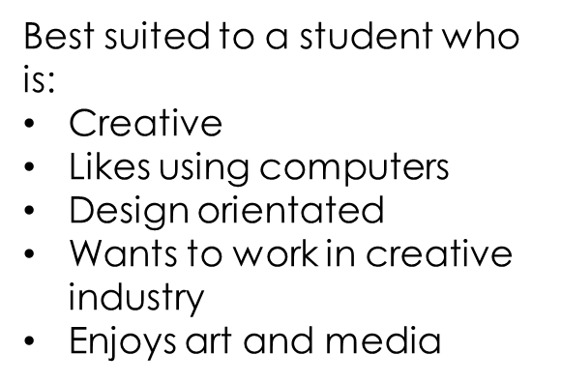
Recap

Slide 17
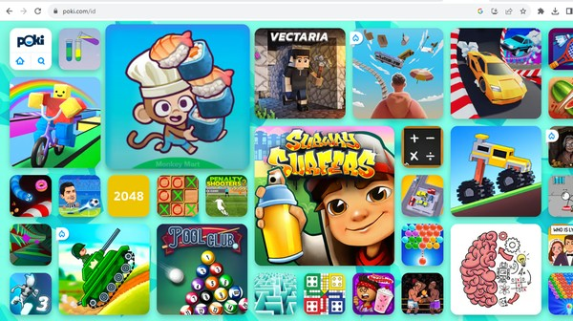
What both courses are not…

