Slide 1
Cambridge National
Sport Studies
Sport Studies will develop knowledge, understanding and practical skills that can be used in the Exercise, Physical Activity, Sport and Health sector.

Slide 2
What skills and knowledge will I learn?
• How technology is used in sport
• How to develop as a team player and how to develop as a leader
• Plan, deliver and evaluate your own sports activity session
• Performing in front of an audience
• The connection between sport and media, and the different ways that sport is represented
• Local and national outdoor activities, how to prepare and benefit from them

Slide 3
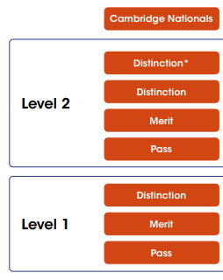
How am I assessed?
The three units that will be assessed are:
Unit R185: Performance and leadership in sports activities
(Internal assessment that is externally verified)
Unit R187: Increasing awareness of outdoor and adventurous activities
(Internal assessment that is externally verified)
Unit R184: Contemporary Issues in Sport
(Externally Assessed Set Examination paper- 1 hr 15 minutes)

Slide 4
What employability skills will I develop?
Analytical skills
Creative thinking
Leadership
Research and planning
Team work
Self management
Verbal communication and presentation skills.

Slide 5
Where can this subject lead on to at post 16?
Level 3 vocational qualifications such as:
Cambridge Technical in Sport and Physical Activity
BTEC Tech Award Level 3
Physical Education AS or A-Levels
Apprenticeships in Community Sport and Health Officer, Leisure Duty Manager, Physiotherapist (degree)
Then lead into Higher Education such as University degrees and the careers mentioned on the next slides.
Notes:
These skills will help you progress onto further study in the Exercise, Physical Activity, Sport and Health sector.

Slide 6
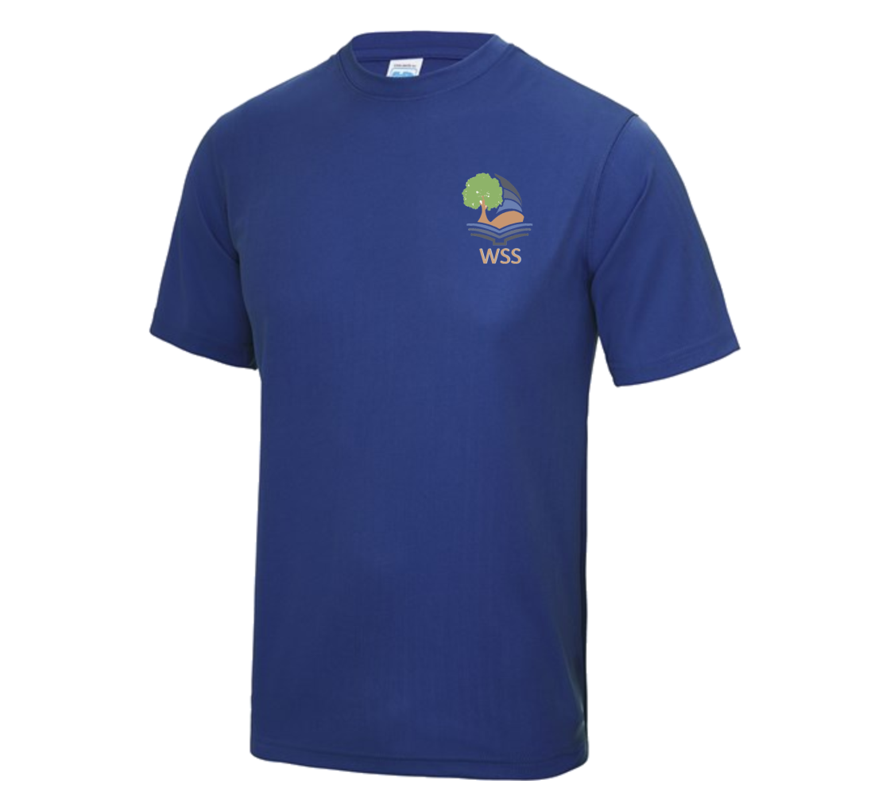
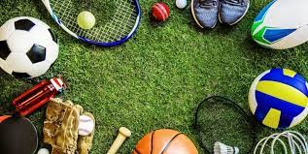
Who is this course for?
Students who are interested in sport.
Students who play sport in and outside of school.
Students who watch and follow sport on TV and other forms of social media.
Students who are confident and have an interest in leadership and taking responsibilities.
Students who bring PE kit to every lesson.
Students who engage in PE lessons with enthusiasm and 100% effort.

Slide 11
Core PE
If you do not choose to study Sport Studies, you will still take part in core PE as this is a compulsory subject.

