Slide 1
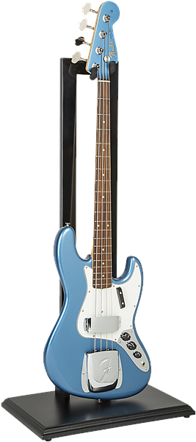
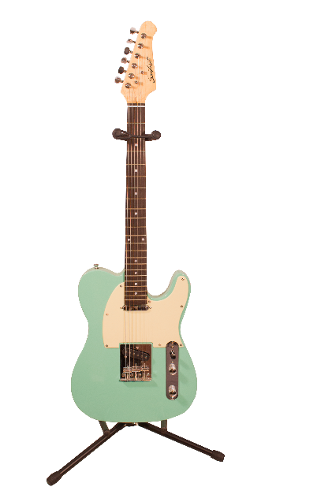
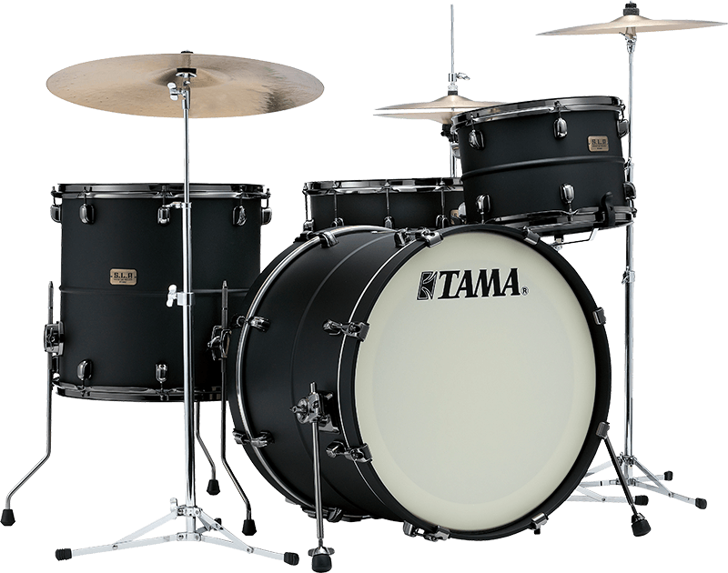
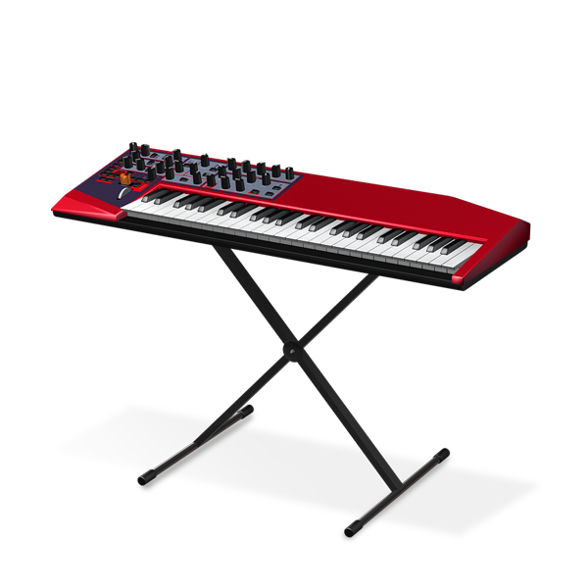
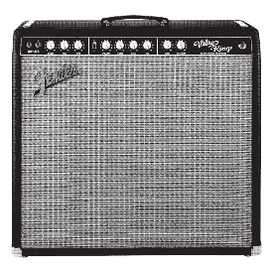
BTEC Tech Award Music Practice

Slide 2
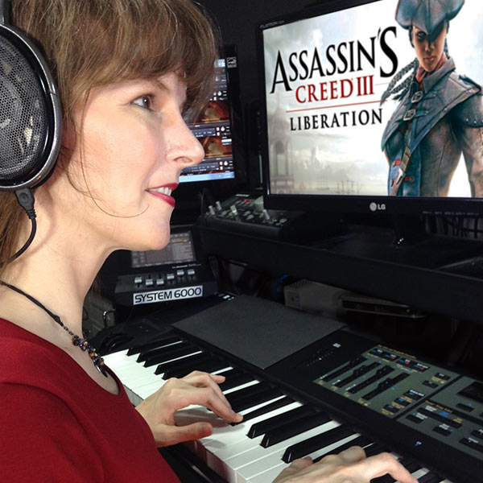
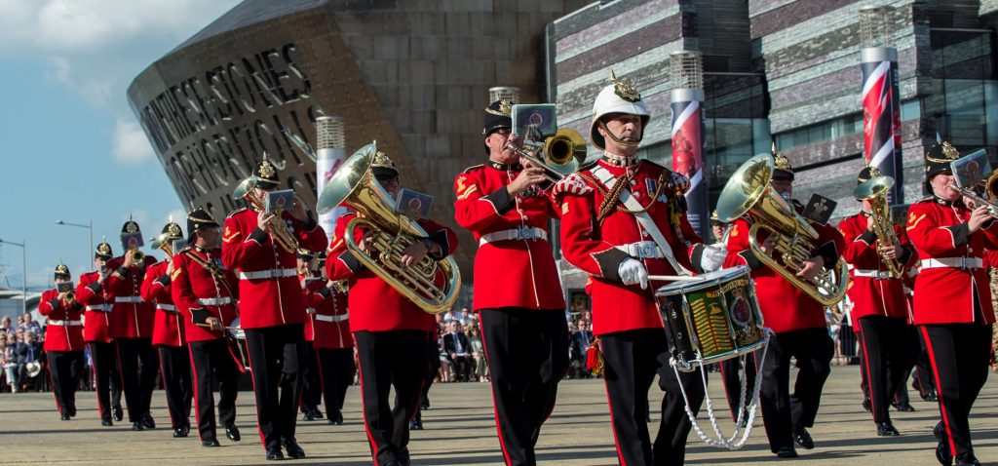
Breaking the Myth

Slide 3
Careers in music
Music Producer
Sound Engineer
Sound Technician
Record Producer
Music Producer
Songwriter
Film Composer
A&R (artist & repertoire) Manager
Music Journalist
Musical Director
Music Therapist
Tour Manager
Luthier
Session Musician
Music Teacher
Booking Agent
Music Publicist

Slide 4
Careers in music
Game Composer
Music Arranger
Live Event Technician
Digital Marketing Manager
Royalties Assistant
Music Data Administrator
Musician/ Performance Artist
DJ
Conductor
Piano Tuner
Events Organiser
Record Label Entrepreneur
Singer
Instrumental Tutor
Army Musician
Commercial Music Composer
Music Software Developer
Venue Manager

Slide 5
Benefits of studying Music
Develops critical thinking and problem solving
Emotional intelligence and empathy
Self-Confidence
Communication and presentation skills
Enhanced memory function
Imagination
Cooperation and working with others
Spontaneity - thinking on your feet

Slide 6
What will I study?
Year 10:
Perform and compose in a range of musical genres: Britpop, film music, reggae, disco, African drumming, rock n’ roll, EDM (electronic dance music)
Learn to critically analyse music and improve your understanding of these styles
Use music technology to arrange and produce your own music

Slide 7
What will I study?
Year 11:
Further refine your instrumental skills and work on your stage craft in a live performance setting
Develop professional and commercial skills for the music industry
Learn studio recording and sound engineering skills associated with live performance
How to respond to a commercial music brief

Slide 8
How Will I be assessed?
3 components over two years
3 assessment points over two years
Year 10 - Component 1:
Create 3 music products (performance, studio recording, DAW project)
Produce a written portfolio that demonstrates your understanding 4 contrasting styles of music

Slide 9
How Will I be assessed?
3 components over two years
3 assessment points over two years
Year 11 - Component 2:
Students plan and create 2 musical outcomes in different musical areas (performance/ composition/ DAW project) in response to a theme that will develop professional and musical skills.
As well as their completed products, students submit a written portfolio/ project diary.

Slide 10
How Will I be assessed?
3 components over two years
3 assessment points over two years
Year 11 - Component 3: EXTERNAL ASSESSMENT
Students create 1 musical outcome in their choice of musical area (performance/ composition/ DAW project) in response to a brief.
You will be given a list of 10 songs to choose from and have to ‘arrange’ your chosen song into another style. You will then either perform or record your chosen song.

Slide 11
What can I go on to study?
BTEC Level 3 Music or Music Technology
RSL Level 3 Extended Diploma for Music Practitioners
Music Performance
Music Technology
Composition
Music Business
A Level Music or Music Technology
Vocational Music Performance & Technology (Triple Award)

Slide 12
Could I have a career in the performing arts industry?
If you want a career that is emotionally fulfilling, constantly varied, artistically, creatively and technically challenging then ask yourself:
Can I thrive in a highly competitive environment?
Am I adaptable, enterprising, persistent, resilient and determined to succeed?
For more information about the course or any of these careers please ask a member of the Performing Arts team.

