Slide 1
BTEC Engineering
Year 9 Options Information Assembly

Slide 2
FAQs
How will I be assessed?
What skills and knowledge will I learn?
What employability skills will I develop?
Where can this subject lead to?
What career opportunities or pathways would link directly to this subject?

Slide 3
BTEC Engineering How will I be assessed?
30% of your final grade during Year 10

Slide 4
BTEC Engineering How will I be assessed?
30% of your final grade during Year 10
30% of your final grade during Year 11

Slide 5
BTEC Engineering How will I be assessed?
30% of your final grade during Year 10
40% of your final grade as a written exam taken in Yr11
30% of your final grade during Year 11

Slide 6
BTEC Engineering How will I be assessed?
30% of your final grade during Year 10
5 written assignments together with a practical task
40% of your final grade as a written exam taken in Yr11
30% of your final grade during Year 11

Slide 7
BTEC Engineering How will I be assessed?
30% of your final grade during Year 10
5 written assignments together with a practical task
40% of your final grade as a written exam taken in Yr11
30% of your final grade during Year 11
5 written assignments together with a computer aided design practical task

Slide 8
BTEC Engineering How will I be assessed?
30% of your final grade during Year 10
5 written assignments together with a practical task
40% of your final grade as a written exam taken in Yr11
30% of your final grade during Year 11
1 exam lasting 1 ½ hours
5 written assignments together with a computer aided design practical task

Slide 9
BTEC Engineering What skills and knowledge will I learn?
The course is for student wanting to develop applied knowledge and practical skills in engineering manufacture -

Slide 10
BTEC Engineering What skills and knowledge will I learn?
The course is for student wanting to develop applied knowledge and practical skills in engineering manufacture - theory and practical work

Slide 11
BTEC Engineering What skills and knowledge will I learn?
The course is for student wanting to develop applied knowledge and practical skills in engineering manufacture - theory and practical work
Students who want to progress onto other related study, such as qualifications in Engineering or Design and Technology –

Slide 12
BTEC Engineering What skills and knowledge will I learn?
The course is for student wanting to develop applied knowledge and practical skills in engineering manufacture - theory and practical work
Students who want to progress onto other related study, such as qualifications in Engineering or Design and Technology – can lead to jobs in Engineering

Slide 13
BTEC Engineering What employability skills will I develop?
The qualification will also help you to develop learning and skills that can be used in other life and work situations, such as:

Slide 14
BTEC Engineering What employability skills will I develop?
The qualification will also help you to develop learning and skills that can be used in other life and work situations, such as:
Solving problems by exploring different engineering manufacture processes, tools, equipment and materials

Slide 15
BTEC Engineering What employability skills will I develop?
The qualification will also help you to develop learning and skills that can be used in other life and work situations, such as:
Solving problems by exploring different engineering manufacture processes, tools, equipment and materials
Planning a sequence of processes. This will involve managing your time and identifying the resources you will need, as well as reviewing your plans if necessary

Slide 16
BTEC Engineering Where can this subject lead to?
Note: This qualification will NOT give you the skills and knowledge to be a fully qualified car mechanic.

Slide 17
BTEC Engineering Where can this subject lead to?
Note: This qualification will NOT give you the skills and knowledge to be a fully qualified car mechanic.
However,

Slide 18
BTEC Engineering Where can this subject lead to?
Note: This qualification will NOT give you the skills and knowledge to be a fully qualified car mechanic.
However,
A good grade will open opportunities at local colleges to further study Engineering

Slide 19
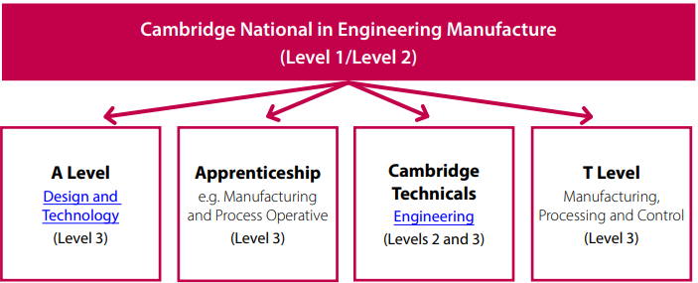
BTEC Engineering What career opportunities or pathways would link directly to this subject?

Slide 20
BTEC Engineering What career opportunities or pathways would link directly to this subject?
Southampton City College
Electrical Installation

Slide 21
BTEC Engineering What career opportunities or pathways would link directly to this subject?
Southampton City College
Eastleigh College
Electrical Installation
Performing Engineering Operations

Slide 22
BTEC Engineering What career opportunities or pathways would link directly to this subject?
Southampton City College
Eastleigh College
Electrical Installation
Performing Engineering Operations
Fareham College (CEMAST campus)
Diploma in Motorsport Vehicle Maintenance and Repair

Slide 23
BTEC Engineering What career opportunities or pathways would link directly to this subject?
Southampton City College
Eastleigh College
Electrical Installation
Performing Engineering Operations
Fareham College (CEMAST campus)
Barton Peveril
Diploma in Motorsport Vehicle Maintenance and Repair
Engineering Extended Certificate

Slide 24
BTEC Engineering What career opportunities or pathways would link directly to this subject?
Southampton City College
Eastleigh College
Solent University
Electrical Installation
Performing Engineering Operations
Renewable Energy Engineering Degree (BEng)
Fareham College (CEMAST campus)
Barton Peveril
Diploma in Motorsport Vehicle Maintenance and Repair
Engineering Extended Certificate

Slide 25
BTEC Engineering What career opportunities or pathways would link directly to this subject?
Southampton City College
Eastleigh College
Solent University
Southampton University
Electrical Installation
Performing Engineering Operations
Renewable Energy Engineering Degree (BEng)
Civil Engineering Degree (BEng)
Fareham College (CEMAST campus)
Barton Peveril
Diploma in Motorsport Vehicle Maintenance and Repair
Engineering Extended Certificate

Slide 26
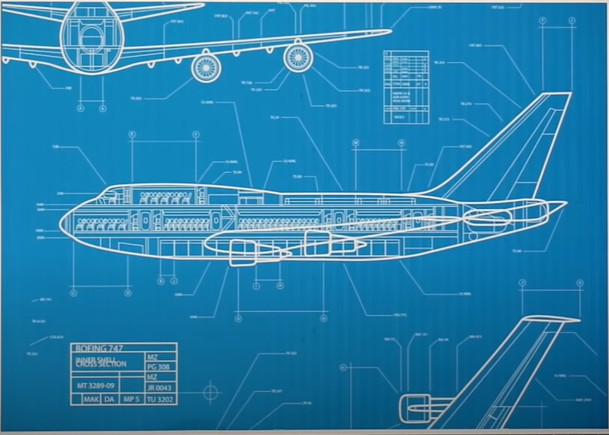
BTEC Engineering How many different types of Engineer are required to build an airliner?

Slide 27
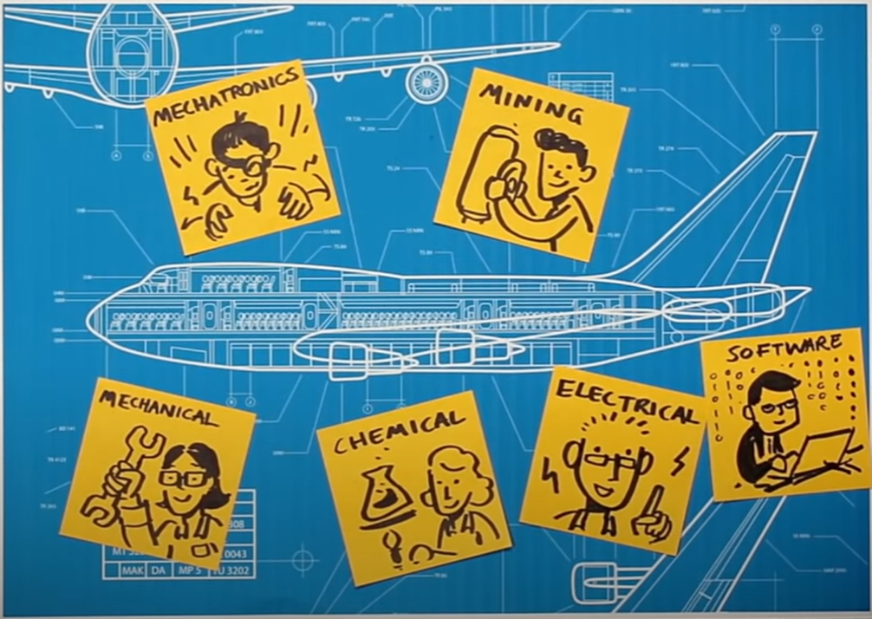
BTEC Engineering Answer:

Slide 28
BTEC Engineering Answer: quite a few!

