Slide 1
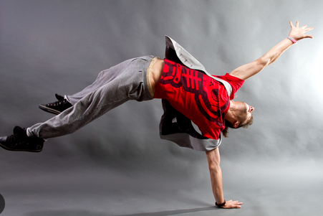
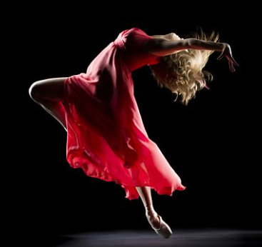
Year 9 Options Roadshow
Btec Tech Award in Dance

Slide 2
The Importance of Dance: Transferable Skills – The Power of Dancing!
All very beneficial in any career pathway and quality of life!
Studying Dance helps you develop:
Self-Confidence, Self-Expression, Self Discipline
Imagination, Creativity, Risk Taking
Emotional Intelligence and Empathy
Cooperation and Teamwork
Communication and Presentation Skills
Higher Order Critical Thinking and Problem Solving Skills
Leadership Skills
A Healthy Self Image

Slide 3
Careers in Dance
Dance Movement Therapist
Dance Journalist
Dance Lecturer or Academic Researcher
Dance Photographer
Dance Project Coordinator
Dance Producer
Notation/Choreology Pilates/Yoga Instructor
Talent Agent
Fitness Coach
Specialised Dance Teacher
Dance/Arts/Culture Officer
Dance Company Education Specialist
Dance Film Maker
Dancer
Choreographer
Dance Teacher
Dance Critic
Educational Dance Workshop Organiser
Educational Dance Workshop Leader
In House Dance Residence
Community Dance Practitioner

Slide 4
What will I Study in the Btec Tech Award in Dance?
You will study 3 Units:
Component 1 – Exploring the Performing Arts
This means you will learn dance technique and choreography from different dance styles and professional dance works.
Component 2 – Developing Skills and Techniques in the Performing Arts.
This means you will develop your own technical dance and performance skills resulting in a performance to a live audience.
Component 3 – Responding to a Brief
This means you have to make up a 7-15 min Dance piece in a group based on a set theme given by the examination board.

Slide 5
What does the course look like?
You will have practical lessons where you will explore different dance styles and technique as well as lessons in an IT room whereby you will research and learn about famous dance choreographers. You will have the opportunity to be a Dancer, Choreographer and Dance Critic!
You will complete Component 1 – In Yr. 10.
You will complete Component 2 and 3 in Yr. 11.
You do not have to sit any written exams however you do have to produced detailed written coursework for each component.

Slide 6
How am I assessed?
Component 1 – You must produce a 20 page PowerPoint based on a professional dance work.
Component 2 – You must perform a Dance piece to a live audience, write a rehearsal log and complete an evaluation.
Component 3 – You must perform a 7-15min Dance and complete three written tasks under exam conditions.
Each Component is moderated and sent to an external examiner. You will receive a grade for each component. The three grades are then added together to make your final mark.

Slide 7
What can I go on to study?
Vocational Level 3 Courses in Dance, Drama or Musical Theatre
A Level Dance, Drama
Level 3 Course in Theatrical Hair and Media Make Up.
Dance and Musical Theatre Triple Award Diploma
Level 3 Diploma in I.S.T.D Dance
Anatomy and Physiology (A&P) Level 3 Certificate

